Slide 1
The Blame Game:
A New Era of Policing Affiliate Marketing
in the Post-Trump World
@IntegriShield @TheRealMsHirsch ftcbeat.com

Slide 2
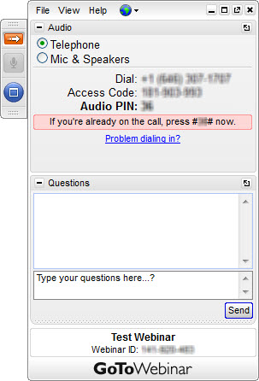
Housekeeping - Audio Instructions
Select “Telephone” to dial in via phone
OR
Select “Mic & Speakers” for VOIP

Slide 3
Housekeeping - Today’s Attendee Control Panel
Grab Tab
Questions / Chat

Slide 4
Housekeeping
Webinar will be recorded and emailed to all attendees.
Join the conversation!
Submit questions via GoToWebinar control panel
Live tweet us @IntegriShield using #Compliance
The information provided does not constitute legal advice. Contact your attorney for more information on the topics presented. This presentation is for informational purposes only.

Slide 5
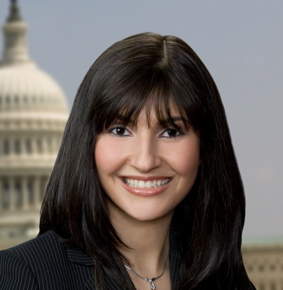
Speakers
Rachel Hirsch
Senior Associate, Ifrah Law
Gayla Huber
President, IntegriShield

Slide 6
Takeaways
Trump Administration’s Stance on Federal Regulatory Enforcement
Principles of past FTC settlements dictating how affiliate marketers police themselves
Affiliate Network Liability vs. Advertiser Blame
New “cops on the beat”
Real-world measures to help mitigate exposure to liability

Slide 7
How the Trump Administration’s stance on federal regulatory enforcement will affect affiliate marketing?

Slide 8
Open for Business
Innovation
Edge Marketing
Salesmanship
Possible decline in enforcement around marketing if perceived as innovative, creative, or effective.

Slide 9
Is Regulation Dead?
Notes:
Trump’s “2-for-1” Regulation Executive Order Means a Lull in New Regulation
Measure meant to protect and foster growth of small businesses
Regulators face the task of deciding which regulations to cut
Regulation reduction might result in regulations that are longer and more complex

Slide 10
Is the CFPB Dead?
Agency intended to be “new cop on beat” in consumer financial protection
Its creation was authorized by the Dodd-Frank Act of 2010 to address the financial crisis
The agency was the brainchild of Democratic Senator Elizabeth Warren
Trump administration has called the Dodd-Frank Act “a disastrous policy” that created an “unconstitutional” new agency
Notes:
In 2017 – already 5 times more enforcement actions than any other year

Slide 11
How is the CFPB Unconstitutional?
A single director, Richard Corday, leads both rule-making and enforcement and can only be dismissed only for cause
Agency is funded by U.S. Federal Reserve system, which means it is not dependent on typical congressional appropriations process
Republican-led House of Representatives Financial Services Committee passed legislation in September that would change the name and structure of agency and create 5-member commission to govern it

Slide 12
How is the CFPB Unconstitutional?
In October 2016, D.C. Circuit Court of Appeals found structure of CFPB to be unconstitutional given its autonomous structure.
Decision of the court was response to a petition from mortgage lender PHH, which challenged an enforcement action from agency and called for CFPB to be eliminated
Court took issue with inability for other arms of government to review and rebuke Bureau’s judgments or actions
Court also took issue with the “unilateral power” imbued in the CFPB’s director
Ruling vacated a $109 million enforcement action against PHH, sending case back to CFPB for review

Slide 13
Business as Usual for the CFPB . . . For Now
Regulation Executive Order does not appear to impact rule-making by independent agencies like the SEC, FDIC, OCC, and CFPB
But Trump’s Executive Order directing Secretary of Department of Treasury to begin reviewing Dodd-Frank and its associated laws likely to impact CFPB
Republicans continue to lead effort to repeal and replace Dodd-Frank Act through more aggressive version of Financial CHOICE Act, which would create five-member commission
Notes:
In 2017 – already 5 times more enforcement actions than any other year

Slide 14
Is the FTC Dead?
Short Answer = No.
Like any federal agency, FTC facing transition under new administration
FTC is run by a bipartisan panel of 5 Commissioners, one of whom is Chairperson
No more than 3 Commissioners can be from the same party
Currently 3 vacancies in Commission, leaving Trump administration with opportunity to have enormous impact on the agency

Slide 15
Is the FTC Dead?
FTC leadership has experienced major shake-up in last year.
Wright
Brill
Phal
Rich
Ramirez

Slide 16
What Can Marketers Expect from the FTC?
Smarter, more streamlined cases
Information-sharing between various offices to initiate new cases
Possibly some delay in settlement approval for bigger, more high-profile cases

Slide 17
What principles of past FTC judgments and settlements will still dictate how affiliate marketers police themselves?

Slide 18
How Has the FTC Legislated in the Past?
Trump’s “2-for-1” Regulation Executive Order will not slow down FTC rule-making
There are still clear legal standards of deception
FTC regulates through its consent orders
E.g., FTC v. Wyndham Worldwide Corporation – U.S. District Court agreed with FTC that its 52 data security consent decrees serve as fair warning to companies.

Slide 19
Why is Legislating Through Consent Orders Unfair?
Consent orders usually the result of high-pressure negotiations
The “No Admit/No Deny” language is silent on culpability of wrongdoer, but is used against future defendants
Consent Orders are not always in line with judiciary’s stance on the law
E.g., FTC v. POM Wonderful – mandate for two randomized controlled trials for “disease treatment” claims

Slide 20
When is an affiliate network liable for the actions of its affiliates and when is the blame be shifted to the advertiser?

Slide 21
Liability
Action
Monitoring
Deception

Slide 22
How have Affiliate Networks been Treated by the FTC?
FTC v. LeadClick – First FTC action against affiliate network to ever go to court
Affiliate network held liable under theory of principal liability under Section 5 of FTC Act (Advertiser, LeanSpa, chose to settle with FTC)
Previously, FTC Telemarketing Sales Rule used to impose liability on anyone who provides “substantial assistance or support” to a deceptive telemarketing campaign while “knowing or consciously avoiding knowing of it”
LeadClick argued statutory immunity under Communications Decency Act’s protection of content-neutral “interactive computer service” from liability for wrongful statements made by “publishers” or “speakers”

Slide 23
How Have Affiliate Networks Been Treated By The FTC?
FTC v. LeadClick – continued
Second Circuit Court of Appeals upheld judgment against LeadClick, finding that defendant may be held liable for deceptive content even if it was not solely responsible for it
Second Circuit based its holding on ample evidence of participating and control, including LeadClick’s:
Recruitment of affiliates with knowledge that fake news sites were common in affiliate marketing
Contractual authority to approve affiliate ads and sites
Edit suggestions for the sites
Discussion of fake news sites with affiliates with knowledge they were being used and failing to stop them
Purchasing of advertising space on genuine news sites for affiliates using fake news sites

Slide 24
When is the Advertiser on the Hook?
Advertiser is always responsible for the content it disseminates on its own or is disseminated on its behalf
Advertiser must actively monitor social media, websites, and ads promoted by its agents and influencers
Advertiser bears the burden of substantiating its claims prior to dissemination
Enforcement action against advertiser does not necessarily mean resulting action against affiliate network or publishers when:
Advertiser is solely responsible for publishing its own ads
Advertiser is solely responsible for all creatives used
Advertiser makes material misrepresentations to its agents in disseminating information
Notes:
Sellers will have to deal with compliant industry leaders who will maintain strict contracts
Sellers will have to deal with marketers who have become used to receiving higher quality/lower volume

Slide 25
When is the Affiliate on the Hook?
FTC may initiate action against affiliate/publisher:
Before, during, and after its enforcement action against advertiser
When FTC needs affiliate/publisher to gather information and evidence against advertiser
When affiliate/publisher goes “rogue” despite active monitoring by affiliate network and/or advertiser

Slide 26
What are the Triggers for Investigation?
Consumer Complaints
Industry-Wide Sweeps
Competitors
Monitoring/Surf Days
Media Stories

Slide 27
Who are the new “cops on the beat” in terms of policing affiliate marketers and advertisers who use them?

Slide 28
Don’t Rule Out State AGs
State AGs willing to step up to the plate to the Trump Administration – e.g., Washington State
Each of the 50 states has its own version of the FTC Act – Collectively Known as the “Little Acts”
Generally tailored to meet specific policy preferences of each particular state
Usually applied to state-specific matters, while FTC act used to regulate broader consumer protection issues on national scale
Notes:
They can also pick up actions taken under the Obama administration and retry those in each state.

Slide 29
Don’t Rule Out State AGs
Joint investigations and Enforcement with FTC
Robocalls
Timeshare Resale Fraud
Weight Loss scams
Mortgage Rescue Scams
Business Opportunity Scams
Rise in Collaborations Due to:
Availability of Civil Penalties Under State Law
Information Sharing – Access to FTC Sentinel Database
Broad Investigative Authority
Pooling of Resources
Notes:
State AGs Double Dipping using prior federal actions
DeVry University to pay $2.75M in deal with N.Y. attorney general for false ads on success of its graduates*
National coalition of attorneys general launches effort to stop embattled college accreditor**
*https://careereducationreview.net/2017/01/exclusive-devry-university-to-pay-2-75m-in-deal-with-n-y-attorney-general-for-false-ads-on-success-of-its-graduates/
**https://www.washingtonpost.com/news/grade-point/wp/2017/01/24/national-coalition-of-attorneys-general-launch-effort-to-stop-embattled-college-accreditor/?utm_term=.07f9ff417452

Slide 30
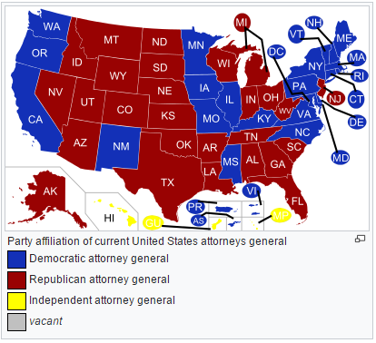
State Attorneys General Party Affiliations
Source: Wikipedia.org

Slide 31
Don’t Rule Out Consumer Watchdog Groups
FTC coordinates and addresses current consumer protection issues with industry-self-regulation groups
E.g., Truth-in-Advertising, Electronic Retailing Self-Regulation Program (ERSP)
Failure to participate or cooperate with self-regulatory groups can result in referral to FTC

Slide 32
Don’t Rule Out Your Competitors
Competitors may “rat you out” for engaging in deceptive practices that undermines their own business
Competitors may file complaint with National Advertising Division (NAD) of Council of BBB for alleged deceptive advertising
Competitors may file complaints directly with the State AG or FTC against companies believed to engage in false advertising
FTC investigation is confidential
FTC will not keep competitor informed of status

Slide 33
Don’t Rule Out Private Plaintiffs
Consumer satisfaction is the key to staving off unwanted scrutiny
FTC relies on consumer complaints to determine what actions to take – a lull in regulation will not mean a lull in enforcement if too many consumers are complaining
Consumers may file private class action lawsuits that precede FTC investigations or even in place of formal enforcement

Slide 34
Cops on the Buyer Side
Industry Associations
Self-Regulatory Programs
Buyers
Advertisers
Notes:
Sellers will have to deal with compliant industry leaders who will maintain strict contracts
Sellers will have to deal with marketers who have become used to receiving higher quality/lower volume

Slide 35
Cops on the Consumer Side
Consumers
Consumer Watchdog Groups
Self-Regulatory Offerings
State AGs

Slide 36
What real-world measures can affiliate networks, affiliates and advertisers implement to help mitigate their exposure to liability?

Slide 37
Mitigating Risks
Monitoring products are not just for your brands
Vet Affiliates, Advertisers, Email Publishers
Strong Agreements
Ongoing online monitoring and seeding of a combination of…
Brand (for the Advertiser) instances across web
Known Affiliate sites
Known Publisher emails
Unauthorized publishers and affiliates

Slide 38
Mitigating Risks - Advertisers
Do your homework/due diligence about the affiliate networks with which you partner
Always include strong language in your contracts
Actively monitor the ads that are being disseminated by the network and its publishers
Actively monitor what endorsers and influencers are saying about your products
Substantiate, substantiate, substantiate!

Slide 39
Mitigating Risks – Affiliate Networks
Never work with an advertiser or affiliate without a contract!
Require your advertisers to complete compliance checklist before signing up
Institute best practices and hold your advertisers and affiliates accountable
Maintain good record-keeping
Conduct period audits, but don’t micromanage
Oversee and limit your employees’ communications with affiliates

Slide 40
It’s Not the Wild West Anymore
Consumers are more educated
Contracts have gotten tougher
Legal pressure from states and social pressure consumer advocacy groups
Advertisers and Affiliates will look to protect their interest

Slide 41
Questions?

Slide 42
Thank You! Contact Us:
Gayla Huber
ghuber@integrishield.com 888-547-7110
Rachel Hirsch rhirsch@ifrahlaw.com 202-524-4145

