Slide 1
Why Compliance Is A Tough Pill To Swallow - Nutraceuticals
Affiliate Summit West Conference | January 13, 2014
Rachel Hirsch, Senior Associate
Ifrah PLLC
David Graff, General Counsel
50 on Red

Slide 2
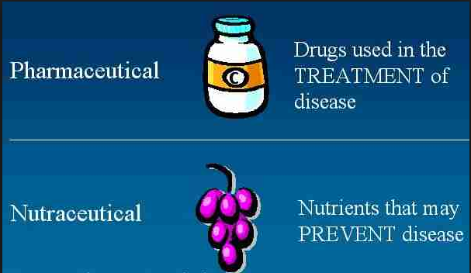
What Are Nutraceuticals?
Has No Fixed Meaning In U.S. Law
Coined From Words “Nutrition” And “Pharmaceutical”
Applies To Products That Range From Isolated Nutrients, Dietary Supplements and Herbal Products, Specific Diets and Processed Foods

Slide 3
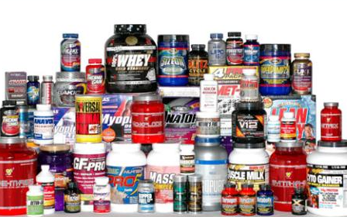
What Are Dietary Supplements?
The Term is Defined In The Dietary Supplement Health and Education Act (DSHEA) of 1994.
It Is A Product Taken By Mouth That Contains a “Dietary Ingredient To Supplement The Diet.”
It May Include:
Vitamins
Minerals
Herbs/Botanicals
Amino Acids
Enzymes
Organ Tissue
Glandulars
Metabolites
It Can Also Be Extracts Or Concentrates And Can Be Found In Many Forms Such As: Tablets, Capsules, Softgels, Gelcaps, Liquids, Or Powders.

Slide 4
How Are Dietary Supplements Different Than Drugs?
Generally, Dietary Supplements Do Not Have To Be Approved By The FDA Before Marketing.
BUT: Companies Must Register Their Manufacturing Facilities With the FDA.
With A Few Well-Defined Exceptions, Dietary Supplements May Only Be Marketed To Support The Structure Or Function of the Body And May Not Claim To Treat A Disease Or Condition.
It Must Be Labeled As a Dietary Supplement And Include FDA Disclosure: “These statements have not been evaluated by the Food and Drug Administration. This product is not intended to diagnose, treat, cure, or prevent any disease.”

Slide 5
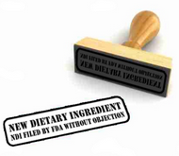
When Does The FDA Need To Be Notified Of A Dietary Supplement?
The DSHEA Requires That A Manufacturer Or Distributor Notify FDA If It Intends To Market A “New Dietary Ingredient” (“NDI”).
An NDI Is Defined By Statute As:
“a dietary ingredient that was not marketed in the United States before October 15, 1994.”
There Is No Authoritative List Of Dietary Ingredients That Were Marketed Before October 15, 1994.
Changes In The Manufacturing Process For A Pre-DSHEA Dietary Ingredient May Create An NDI – e.g., extract of plant leaves.

Slide 6
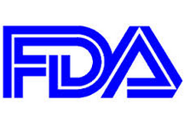
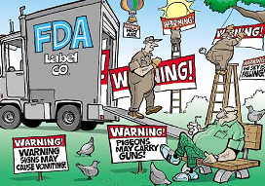
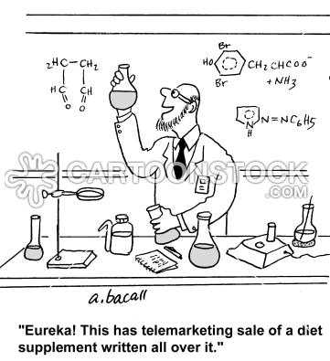
Which Agency Oversees The Marketing Of Dietary Supplements?
The FDA and FTC Share Jurisdiction Through A Liaison Agreement.
FDA Has Primary Enforcement Responsibility for Claims Made In Labeling And Packaging Under The Food, Drug and Cosmetic Act, As Amended By The DSHEA.
Tends To Focus On Product Composition And Safety And Structure/Function Claims Vs. Drug Claims.
FTC Has Primary Enforcement Responsibility For Claims Made In Advertising Generally Under Section 5 Of The FTC Act.
Focused Solely On Advertising – Is it Truthful? Is It Misleading? Is It Adequately Substantiated?

Slide 7
How Do The FTC And FDA Work Together?
FDA Warning Letters Referencing Potential Violations Of The FTC Act, Which Document FDA’s Position That Certain Claims In Advertising Materials Would Not Be Approved By FDA For Use In Labeling.
FTC Orders Requiring Marketers To Gain FDA Approval Prior To Using Certain Claims In Advertising Regulated By The FTC.
Press Releases Announcing The FTC And FDA’s Simultaneous Investigation Of Specific Companies To Assess Violations Of The FDCA And The FTC Act.

Slide 8
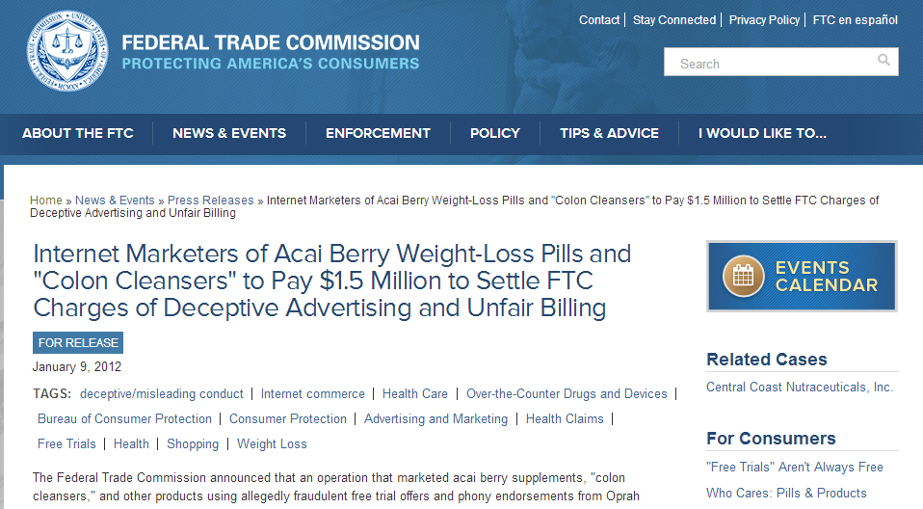
CASE STUDY #1

Slide 9
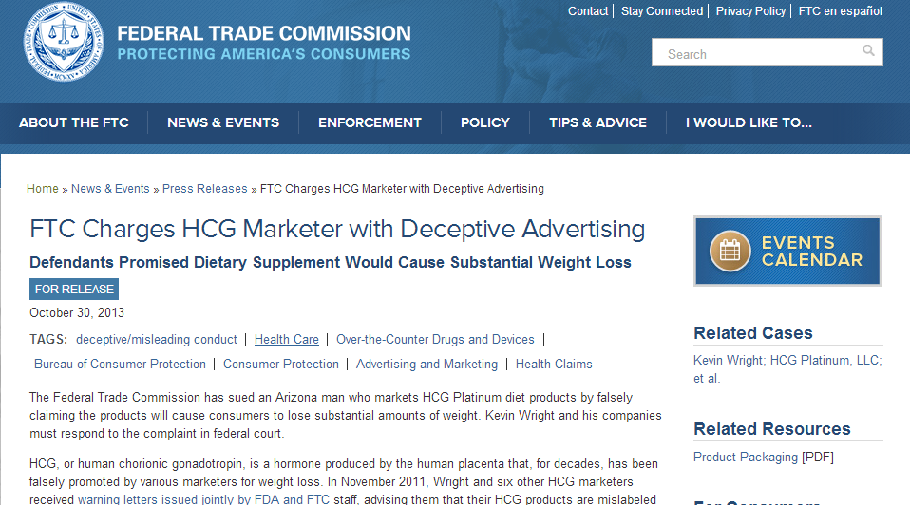
CASE STUDY #2

Slide 10
What Does the FTC Consider Obvious Advertising “Red Flags?”
Section 5 of the FTC Act Prohibits “Unfair Or Deceptive Acts Or Practices In Or Affecting Commerce.”
Causes Weight Loss Of Two Pounds Or More A Week For A Month Or More Without Dieting Or Exercise
Blocks The Absorption Of Fat Or Calories To Enable Consumers To Lose Substantial Weight
Causes Substantial Weight Loss No Matter What Or How Much The Consumer Eats
Causes Substantial Weight Loss For All Users
Causes Permanent Weight Loss (Even When Consumer Stops Using Product)
Causes Substantial Weight Loss By Wearing It On The Body Or Rubbing It Into The Skin
FTC’s Response: “Show Us The Study!”

Slide 11
Which Claims Should Advertisers Beware Of In Marketing Dietary Supplements?
Claims Based On Consumer Experiences Or Expert Endorsements.
Require Clear And Conspicuous Disclosures
“Results May Vary” Not Enough
Claims Based On Traditional Uses.
Consumer Perception Matters
Competent And Reliable Evidence May Be Necessary.
Use Of The DSHEA Disclaimer.
May Be Necessary If Text Or Image Leads Consumer To Believe Product Has Undergone FDA Review
Will Not Cure Otherwise Deceptive Ad – i.e. Claims About Disease Benefit Of Product
Third Party Literature.
May Not Be Used Deceptively and Must Be Explained In Context.
May Impact What Claims Advertiser Will Be Responsible for Substantiating.

Slide 12
What Constitutes Health Claims Substantiation Under The FTC Guidelines?
FTC Has Typically Applied A “Substantiation Standard” Of “Competent And Reliable Scientific Evidence” To Claims About The Benefits And Safety of Dietary Supplements And Other Health-Related Products.
“Competent And Reliable Scientific Evidence” Has Been Defined in FTC Case Law As “Tests, Analyses, Research, Studies, Or Other Evidence Based On The Expertise Of Professionals In The Relevant Area, That Has Been Conducted And Evaluated In An Objective Manner By Persons Qualified To Do So, Using Procedures Generally Accepted In The Profession To Yield Accurate and Reliable Results.”
There Is No Pre-Established Formula As To How Many Or What Type Of Studies Are Needed To Substantiate A Claim.
The Absence Of An FDA Determination That A Health Claim Is Scientifically Valid Will Be A Significant Factor In The Commission’s Assessment Of The Adequacy Of Substantiation For The Claim.

Slide 13
How Does the FTC Health Claims Substantiation Guidance Compare To FDA Guidance?
FTC
Type of Claim
Benefit of a Truthful Claim
Cost of Developing Substantiation
Consequences of False Claim
Amount of Substantiation Believed to be Reasonable
Type of Product
Meaning of Claim
Relationship of Evidence to Claim
Quality of Evidence
Totality of Evidence
FDA
vs.

Slide 14
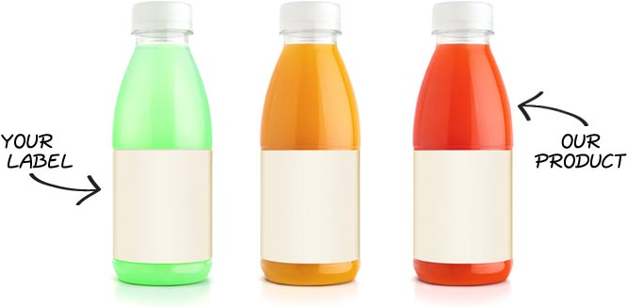
To Whom Does This Guidance Apply?
The Guidance Applies Not Only To Product Manufacturers, But To Product Distributors As Well.
According to the FDA, A Distributor Who Contracts With A Manufacturer to Manufacture Dietary Supplements, Which the Distributor Then Distributes Under Its Own Label, Has An Obligation To Oversee Product Labeling, Manufacturing Activities, and Product Distribution.

Slide 15
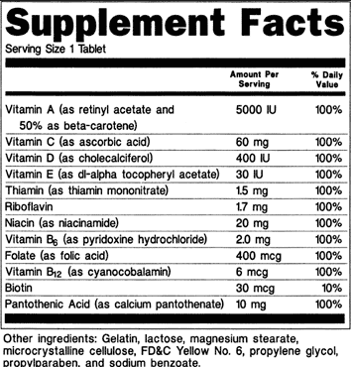
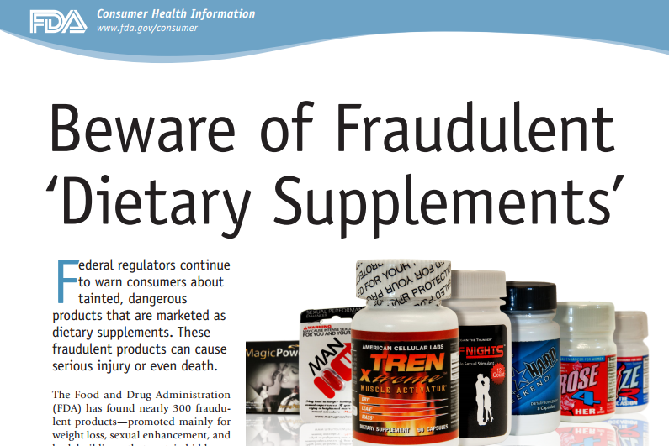
What Can Dietary Supplement Marketers Do To Protect Themselves?
Labeling
Claims
Review All Labels (Including Referenced Website Materials) For Indications for Health Or Nutrient Content Claims And Implied Disease Claims (vs. Allowed Structure/Function Claims
Include: Statement Of Identity, Ingredients Statement, Net Ingredients, Name And Place Of Business, Phone Number, Any Material Information About Use Of The Product, Including Warnings Or Side Effects.
Do NOT Base Labeling On What’s Already In The Market.
Do NOT Make Overblown And Exaggerated Claims.
Include Substantiation For All Claims Of Product Safety Or Effectiveness.
Do NOT Base Your Marketing On Another Product’s Marketing – No Copy And Paste Jobs.
Clinical Studies
Manufacturing Practices
Only Reference Clinical Studies That Are Relevant To Your Product And Qualify Them – i.e. Active Ingredient vs. Finished Product.
If You Conduct Clinical Trials, Register Them With ClinicalTrials.Gov.
Do NOT Reference Clinical Studies On Your Website That Make Implied Drug Claims.
Select A Manufacturer Wisely – Do Your Homework!
Conduct A Mini FDA-Style Inspection – Employ Good Manufacturing Practices
Negotiate A Manufacturing Agreement – Do NOT Be Left Holding The Bag For Product Recall Or Safety Issues.

Slide 16
WHAT ARE THE CONSEQUENCES OF NON-COMPLIANCE?
FTC Enforcement
FDA Enforcement
The FTC Enforcement Process Regarding Advertising Usually Begins In One Of Two Ways: (1) A Letter From An FTC Attorney (Access Letter); or (2) A Civil Investigation Demand (CID) That the FTC Itself Issues.
The Investigation Generally Remains Non-Public Until The FTC Decides Whether To Initiate A Formal Action – Either Announcement Of Proposed Consent Order Or Decree Or A Press Release Regarding Charges Filed.
If You’re Lucky, The FTC Can Issue A “Closing Letter,” Which is Available On Its Website.
If The FTC Choose To File Charges, It Will Seek Disgorgement of “Ill-Gotten Gains.”
The FDA May Conduct An Unexpected Inspection Of Your Facility At Any Time And May Issue A Form FDA 483 To Communicate Concerns Discovered During Inspection.
A Recipient Of a 483 Should Respond Within 15 Business Days Regarding Plan Of Action – Do NOT Tell The FDA To Pound Sand!
All FDA Warning Letters Are Public, Even If The Matter Is Ultimately Closed.
Even After Clean Inspections, FDA May Take Action That Results In A Consent Decree, Seizure, Product Recall, Or Criminal Action.

Slide 17
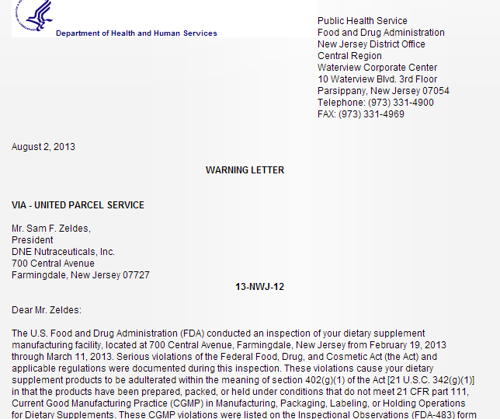
SAMPLE FDA WARNING LETTER #1

Slide 18
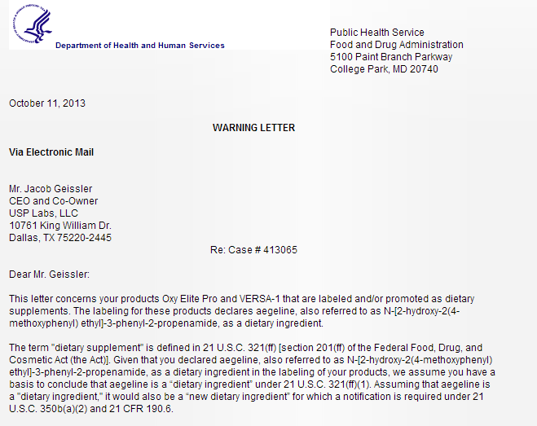
SAMPLE FDA WARNING LETTER #2

Slide 19
HOW DO MARKETERS LAND ON THE GOVERNMENT’S RADAR?
State Attorney Generals
“Surf” Days
Private Litigants
Your Competitors

Slide 20
FINAL THOUGHT
Spending A Little Money Now, Can Save You A Lot Of Money Later – COMPLIANCE, COMPLIANCE, COMPLIANCE

Slide 21
Thank You
Rachel Hirsch David Graff
email: rhirsch@ifrahlaw.com email: dgraff@50onred.com
website: www.ifrahlaw.com website: www.50onred.com
blog: www.ftcbeat.com
@FTCLawyer

