Slide 1
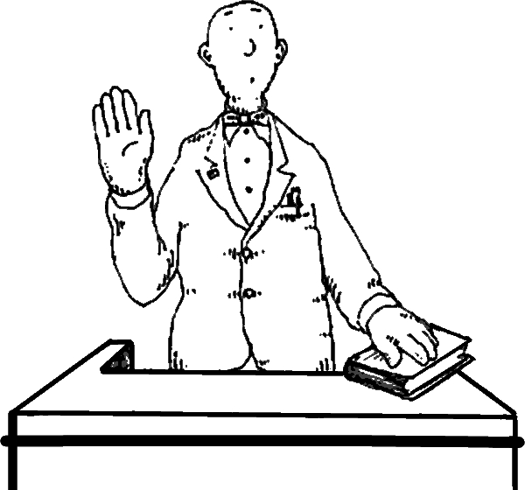
WMACCA Litigation Forum:
The Wild World of Witnesses: When Good Witnesses Go Bad
© Ifrah PLLC / (202) 524-4140 / ifrahlaw.com

Slide 2
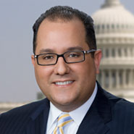
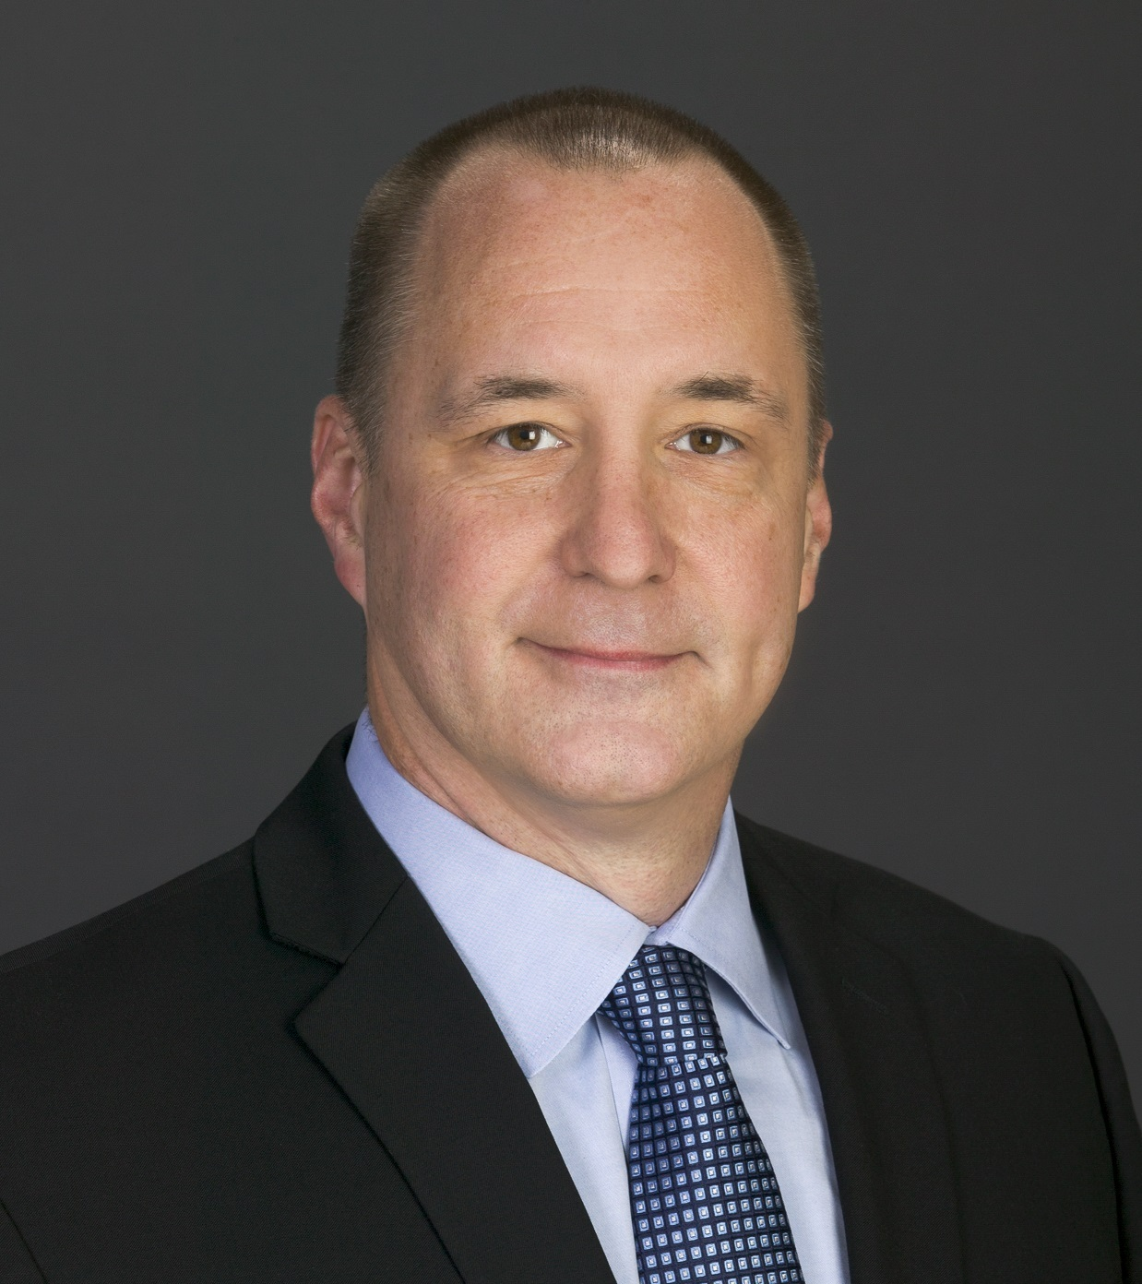
Jeff Ifrah
Speakers
Doug Cox
Founding Member, Ifrah PLLC
Assistant General Counsel, General Dynamics Advanced Information Systems
Michelle Cohen
JC Miller
Member, Ifrah PLLC
Sr. Corporate Counsel, Executive Director Litigation and Employment, XO Communications

Slide 3
Deposition Reality: Preparation is Key
ROLE PLAY: TCPA facsimile advertising allegations and a wacky witness

Slide 4
Research your own
Consider researching your own- because the other side will!
How much depends on the size of organization and importance of the matter

Slide 5
Research Tools
Leverage In-house Counsel’s Knowledge
Strengths
Weaknesses
Sensitivity
Assessment Interview
Employee File
Social Media

Slide 6
Social Media
Social media profile issues

Slide 7
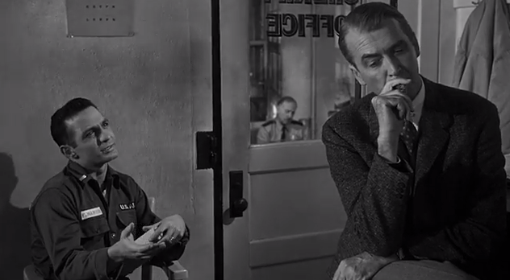
Ethically Preparing Witnesses
ABA Model Rules of Professional Conduct :
Rule 1.2(d): can not counsel client to engage in criminal or fraudulent conduct.
Rule 3.4(b): can not counsel or assist a witness to testify falsely.
Section 116 of the Restatement (Third) of the Law Governing Lawyers confirms there is "relatively sparse authority" on witness preparation, but offers some guidelines.
Anatomy of a Murder; Columbia Pictures, 1959
Scene where the attorney (played by Jimmy Stewart) is in the midst of giving “The Lecture,” to his client who has committed murder

Slide 8
Best Practices – Witness Preparation
Provide general description of case: parties' claims and defenses; key issues in dispute.
Explain objections and instructions to limit or not to answer.
Review of documents.
Review witness’ knowledge or lack of knowledge in detail
Conduct a practice examination.

Slide 9
Best Practices – Witness Preparation (continued)
Attorney-Client Privilege Issues
Reminder for witness to include lawyers on correspondence relating to case
Consideration of participants in preparation to guard attorney-client privilege
During recess in deposition or trial testimony – law more mixed on communications between deponent and deponent’s lawyer – some case law not protected by attorney-client privilege
*In many jurisdictions, it is unethical to coach a witness while a question is pending.

Slide 10
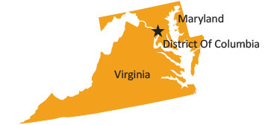
Jurisdictional Differences
District Of Columbia
DC Bar Ethics Opinion No. 79 – if you don’t prepare your witness, failing in ethical duty
Prohibiting contact between the deponent & attorney during deposition breaks is appropriate and customary during a single day of questioning (12 F.R.D. 418 (D. D.C. 2002)) United States v. Phillip Morris, Inc.
Maryland
Rule 2-415(g) – A party can ask deponent to leave the room if an objection is possible coaching
Virginia
Once a deposition begins attorney for witness should not interpret questions or help witness to formulate answers. Francisco v. Verizon South, Inc., 756 F. Supp. 2d 705, 712 (E.D. Va. 2010).

Slide 11
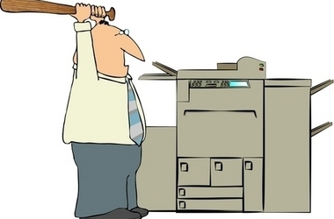
Verbatim: What Is A Photocopier
In 2010, the Cuyahoga County Recorder’s Office in Ohio was sued when it decided to charge $2 per page for public documents.
The case never went to trial. After two years, many depositions and 600 pages of paperwork, the Ohio Supreme Court decided that the Recorder’s Office should make a CD with the documents available to the public. The price? One dollar.

Slide 13
The Ways Witnesses Go Bad
Dealing with the Intimidated Witness
Dealing with the Corporate Speak Witness
Dealing with the Disgruntled Witness
Dealing with the Waffling Witness

Slide 14
How To Make Friends And Influence People: In-House Counsel Edition
DILBERT © 2007 Scott Adams. Used By permission of UNIVERSAL UCLICK. All rights reserved.

Slide 15
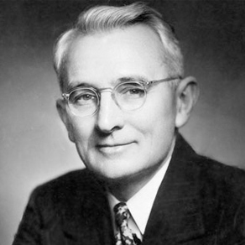
How To Make Friends And Influence People: In-House Counsel Edition (continued)
Managing non-legal management expectations
Pulling key company team members into deposition and trial
Managing up the chain
Setting the stage before it happens
Litigation as a hero rather than a time-waster or irritation

Slide 16
In-House Insights and Take-Aways

Slide 17
Summary of Witness Best Practices
Appearance
Don’t look to sides or down (video deposition)
Don’t look at attorney for answer
Answering Questions
Pause before answering (allows for attorney objections)
Only answer the question asked, and don’t volunteer additional information
Don’t fill the silence
Say “yes” and “no” instead of nodding or shaking head, don’t use “uh-huh”
Other
If you don’t understand the question, say so
Ask for breaks if you need one
TELL THE TRUTH!

Slide 18
Thank You
Questions?
Michelle Cohen, michelle@ifrahlaw.com | Doug Cox, douglas.cox@gd-ais.com
Jeff Ifrah, jeff@ifrahlaw.com | JC Miller, jc.miller@xo.com

