Slide 1
Committee on Casinos: Update on Internet Sweepstakes Café Enforcement Issues
National Council of Legislators from Gaming States
2015 Summer Meeting

Slide 2
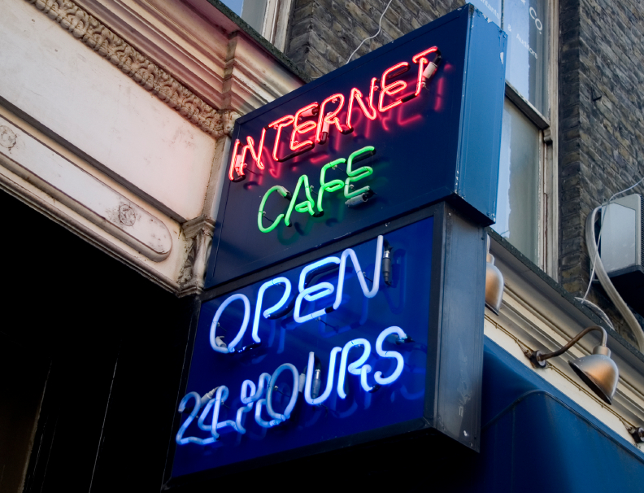
What Exactly Is an Internet Sweepstakes Café?
The cafés advertise and sell a product (i.e. Internet time; long-distance telephone minutes etc.)
The customer receives a bonus of “entries” in the Internet sweepstakes with purchase of product; can purchase more entries
With those entries, the customer can participate in Internet-based games at the cafés specially-programmed personal computers.
Based on a random allocation of winning and losing entries, the customer may or may not win cash prizes through those games

Slide 3
Why Are Internet Sweepstakes Cafés of Concern to States/Law Enforcement?
Attempt to avoid state sweepstakes laws, antigambling laws and gambling licensing restrictions
Internet sweepstakes cafés are estimated to earn more than $10 billion a year with games that closely mimic the experience of traditional slot and video poker machines.
Earning unregulated profits; Pay no state/local gaming taxes
Siphon revenues from state-authorized businesses
Do not educate customers about responsible gaming or contribute funds to combat problem gambling
Lack regulation of:
(1) the integrity of the owners and operators
(2) the fairness of the games
(3) the exclusion of customers too young to gamble
(4) their location, including the proximity to schools or houses of worship

Slide 4
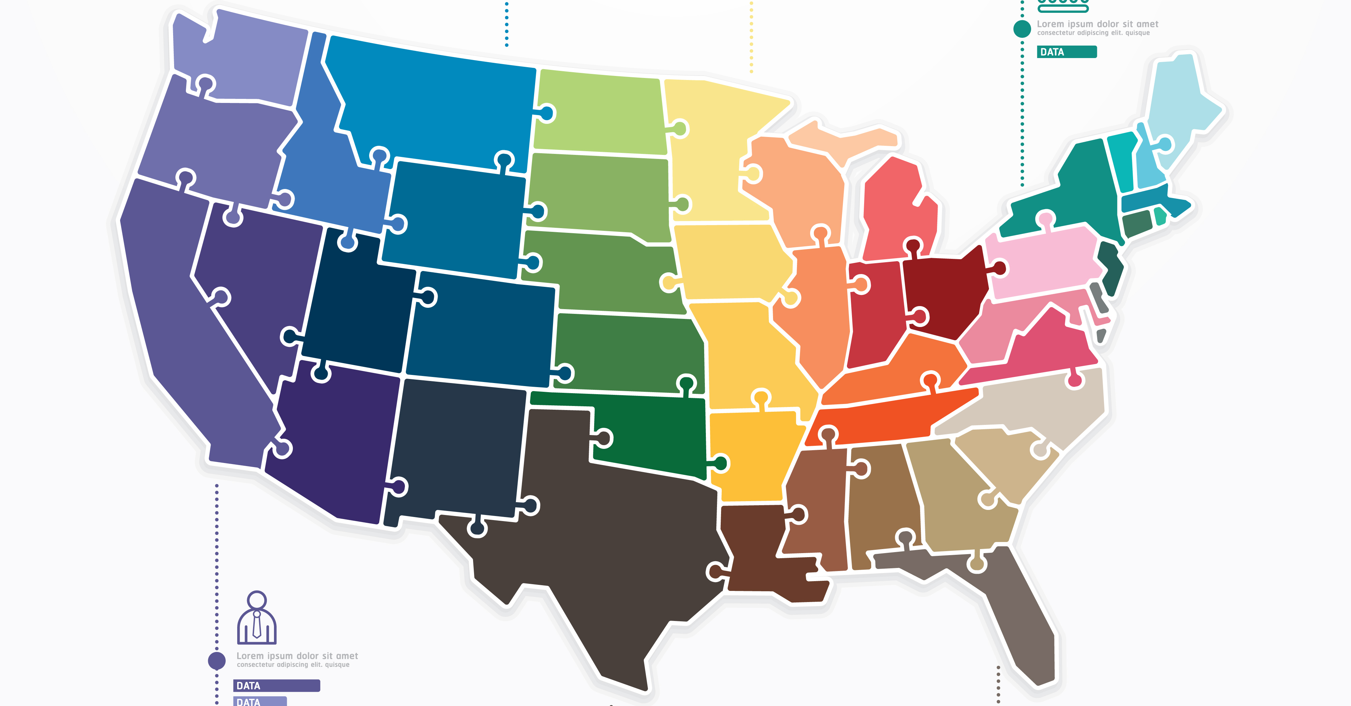
Where Are Internet Sweepstakes Cafés?
Law enforcement efforts have found Internet sweepstakes cafés operating across the country, including in Arkansas, California, Colorado, Connecticut, Florida Georgia, Hawaii, Illinois, Indiana, Louisiana, Maryland, Massachusetts, Michigan, New Hampshire, New Jersey, New Mexico, New York, North Carolina, Ohio, Pennsylvania, South Carolina, Texas and Virginia
States with the most sweepstakes cafés: Florida, Ohio, North Carolina

Slide 5
How Do These Establishments Operate Legally?
Operators claim there is no consideration – “free” entries or the consideration paid for the Internet/long distance time
Claim they are offering sweepstakes similar to major retail brands, but most appeals courts have rejected this argument
Others have challenged laws on First Amendment grounds; or based upon the language of the existing statute – style their games differently than what is explicitly banned
For instance, some reveal the prize up front rather than after play

Slide 6
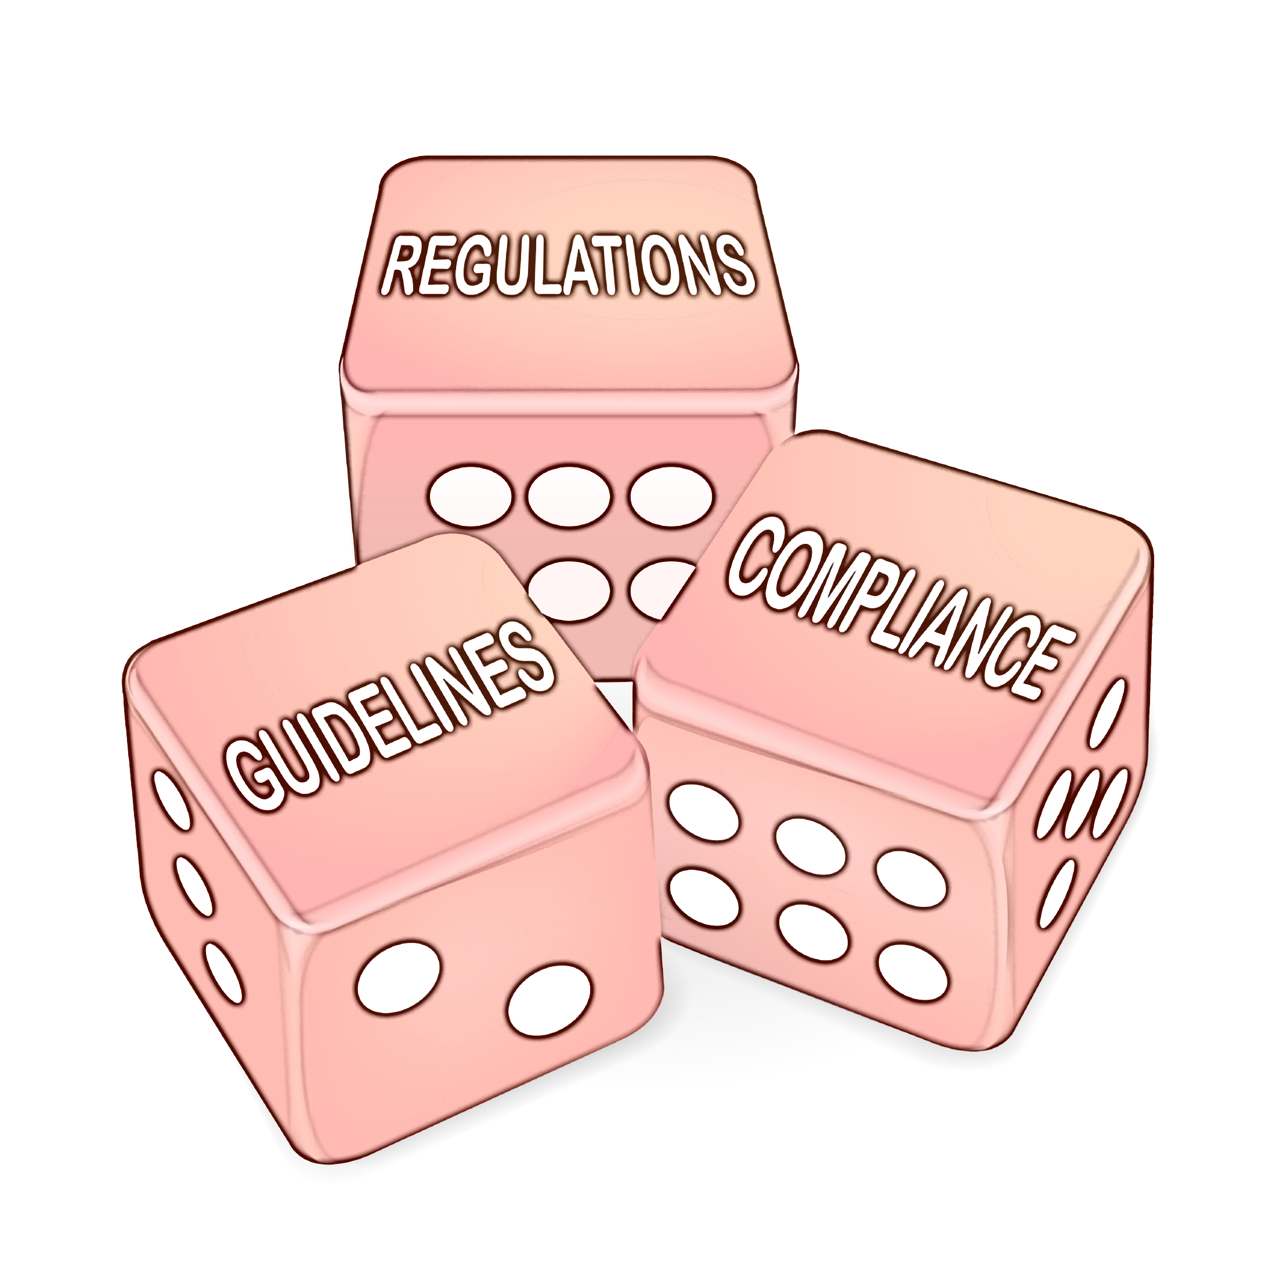
Enforcement Highlights By State
Several states have banned Internet sweepstakes cafés – including California, North Carolina, Ohio, Florida, Massachusetts, New York, Mississippi
Others have issued opinions under existing law
February 2015: Kentucky Attorney General issued an opinion (OAG-15-005) concluding Internet sweepstakes machines meet the definition of illegal lotteries under state law and computers used at Internet sweepstakes cafes constitute illegal gambling devices

Slide 7
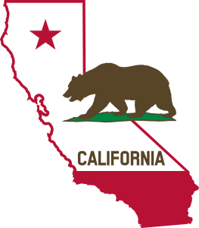
California
Legislation banning Internet sweepstakes
cafés was signed into law in September 2014
The California Supreme Court heard oral
arguments May 6th in an appeal of two appellate
court rulings that made Internet cafés illegal last year
In its first ruling, the appeals court found that sweepstakes or Internet cafés that sell Internet time offer "unlawful slot machine"-style gambling
In its second, the court ruled Internet cafés that sell prepaid telephone cards also offer illegal gambling
Decision expected by August

Slide 8
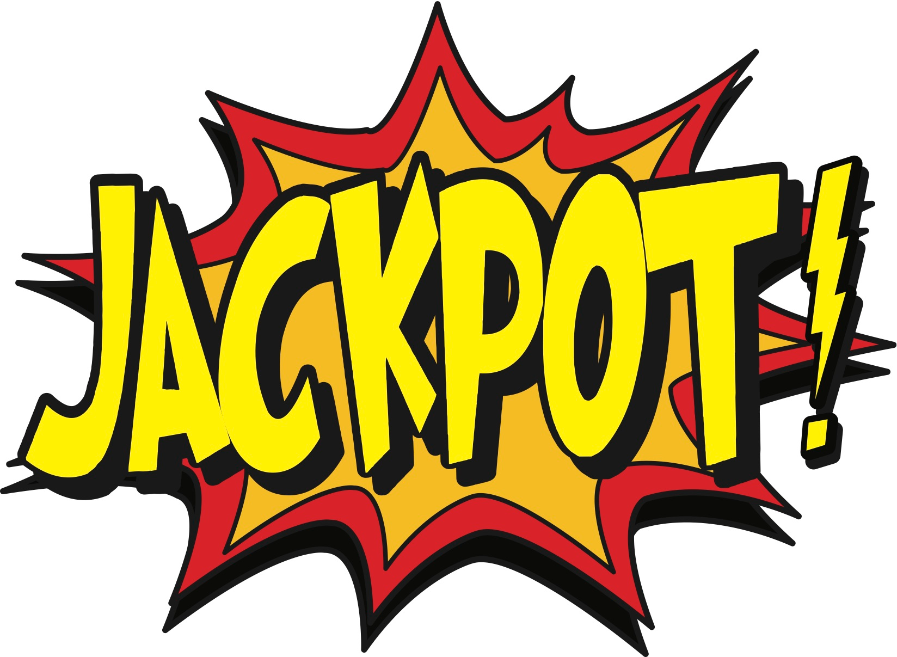
North Carolina
May 2015 – US Attorney reached agreement with several sweepstakes software providers:
will not prosecute the software companies or their principals for the use of alleged illegal internet sweepstakes software in internet cafés across the state
Condition of agreements is by July 1, 2015, providers will no longer have any involvement with sweepstakes in North Carolina involving an entertaining display
The companies supplied to over 600 Internet cafés
Cumberland County Sheriff: “In this case, for several years, video poker machines have been masquerading as sweepstakes. We hope these agreements will stop and deter evasion of North Carolina’s gambling laws”

Slide 9
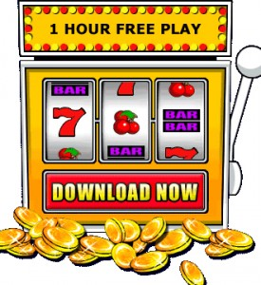
Florida
April 2015: Jacksonville crackdown, the fourth since 2013, when 51 “Allied Veterans of the World” locations around Florida were raided and shut down and almost 60 people arrested
Led to change in state law that outlawed the electronic sweepstakes business
Local lawyer was convicted on multiple counts, sentenced to 6 years (appealing); others plead to lesser charges
Also led to the resignation of Lt. Governor (who had served as a consultant to Allied Veterans)

Slide 10
Colorado & Ohio
Colorado Senate passed House Bill 1047 with no amendments; Takes effect on January 1, 2016
makes internet sweepstakes cafés illegal under Colorado law
June 2013: Ohio Gov. John Kasich signed a new law which makes it unlawful for establishments to pay out cash, gift cards or cash equivalent prizes connected with the operation of the sweepstakes machines
merchandise prizes are limited to those with a wholesale value less than $10

Slide 11
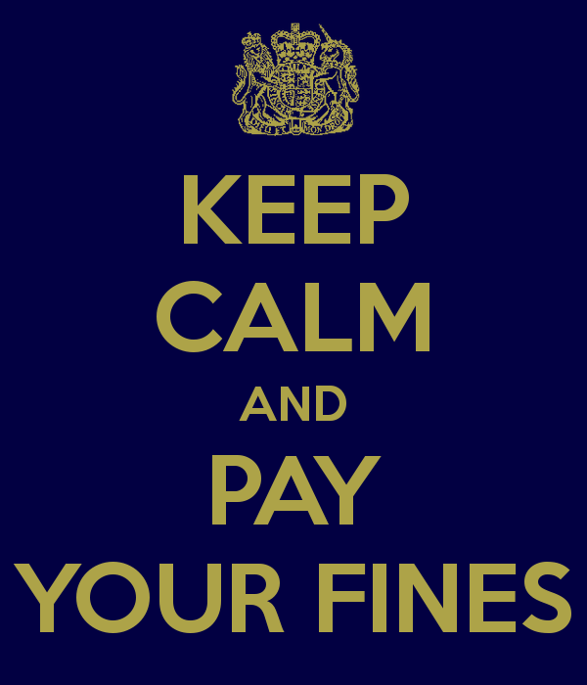
Massachusetts
August 2012: Governor Deval Patrick signed into law legislation that:
establishes a new crime for conducting or promoting an unauthorized sweepstakes that is executed through the use of the entertaining display of an electronic machine\
carries a penalty of up to $250,000 per offending machine and/or imprisonment of up to 15 years in state prison
After allegedly facilitating illegal gambling at locations throughout the state, two so-called Internet cafés, including one owned by former City Councilor Leo Pelletier agreed to pay a total of $750,000 to the state

Slide 12
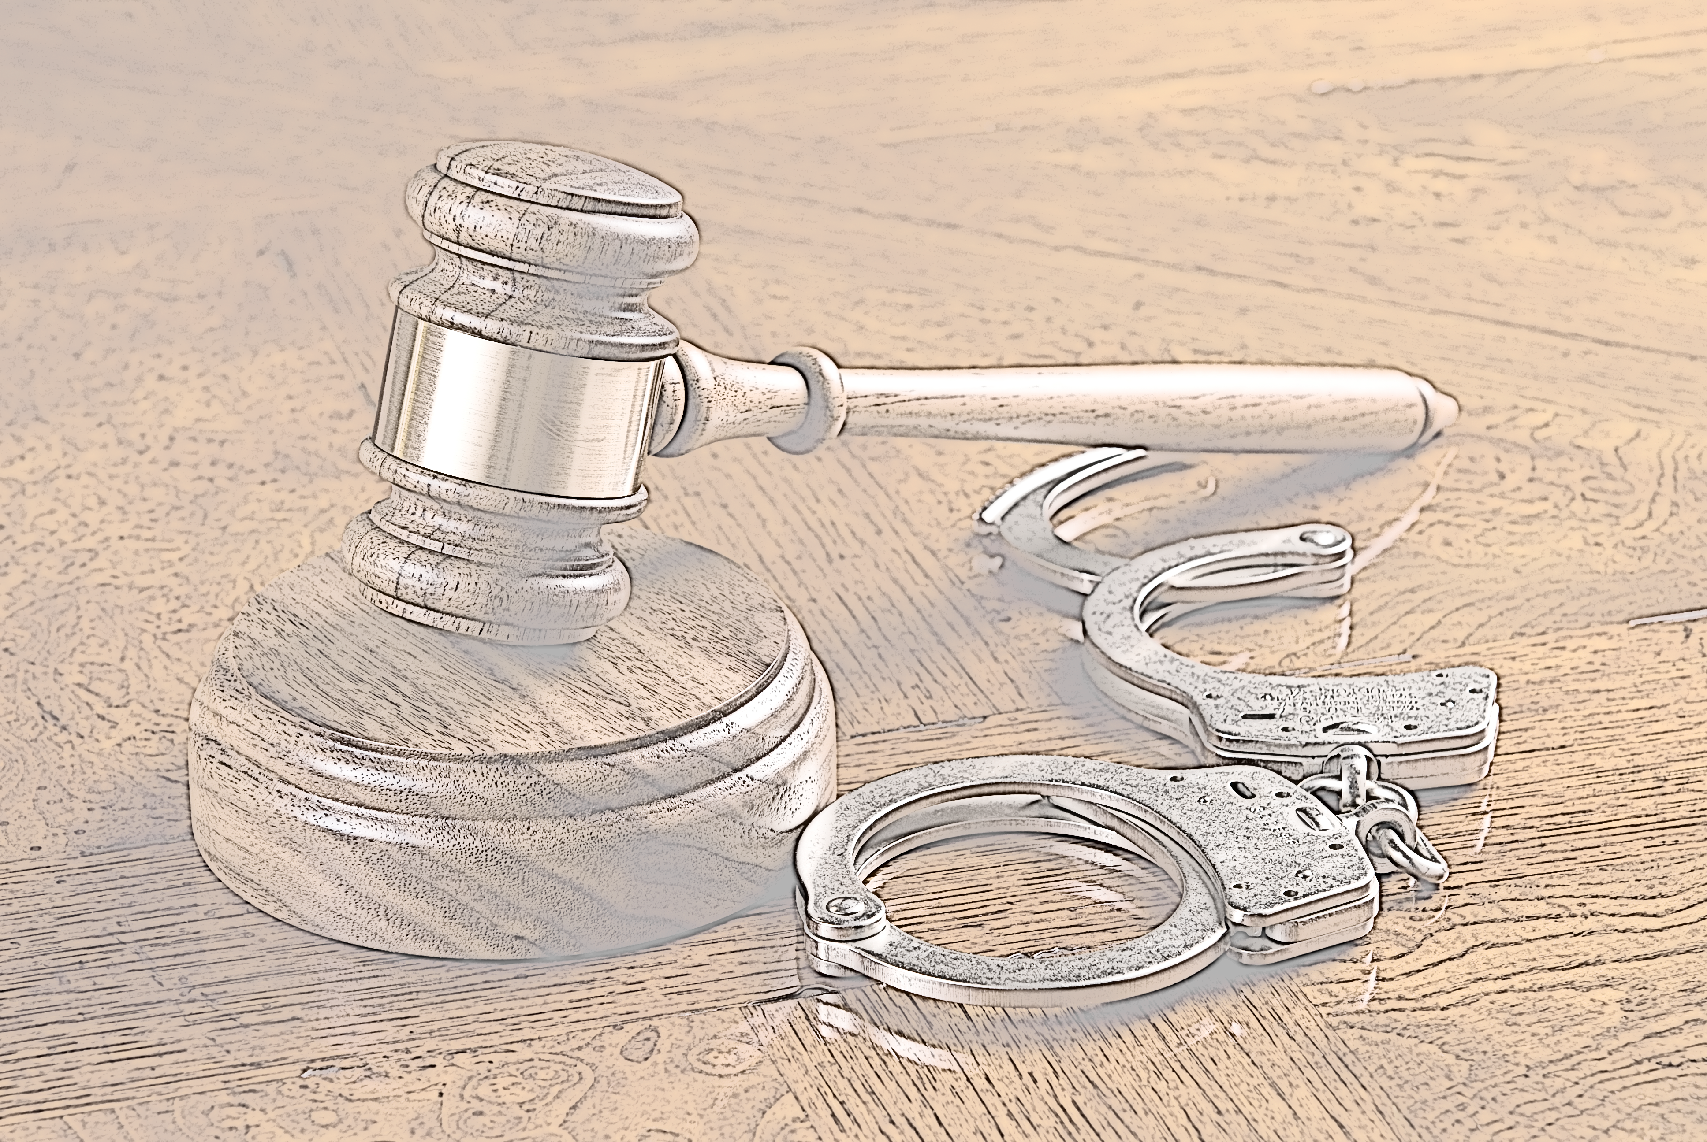
Other Prosecutions…
B & B Cyber Café (Charlotte, NC): The owners plead guilty, and each defendant was sentenced to serve two years of probation and ordered that they forfeit more than $123,000
A Chicopee (MA) cyber café owner and his corporation pleaded guilty to charges of operating an illegal slot parlor and were ordered to forfeit more than $250,000 in assets
In August 2012, two individuals and their corporation pleaded guilty to gaming charges in connection with operations out of Internet cafés in Fall River and Fairhaven (MA) and were ordered to forfeit more than $100,000 in assets

Slide 13
Internet Cafés on the Offensive
J&C Marketing owned two Internet cafés in Cuyahoga County. After investigation, 10 individuals and seven companies were indicted in May 2012 on charges that they had used Internet sweepstakes parlors to promote illegal gambling.
J&C and its owners were not indicted but received letters threatening criminal prosecution unless they stopped the sweepstakes offers. In response, J&C closed its cafés.
J&C sued, arguing it was not promoting gambling because customers did not have to pay to play.
As part of the suit, J&C's lawyers requested to see materials from law enforcement's Internet cafés investigations.
The Ohio Supreme Court ruled in April 2015 that the owners cafés were entitled to see evidence collected by undercover police officers investigating illegal gambling.

Slide 14
Thank you! Questions?
Michelle Cohen | @MichelleWCohen | michelle@ifrahlaw.com
Visit our our blog: IfrahOniGaming.com

