Slide 1
Current and Pending Legislation for Fantasy Sports
August 6, 2015
Miami Beach Convention Center

Slide 2
Panelists
A. Jeff Ifrah Ifrah Law
Christopher Costigan Daily Fantasy Sports 911
Joe Brennan Jr. Industrial Strength

Slide 3
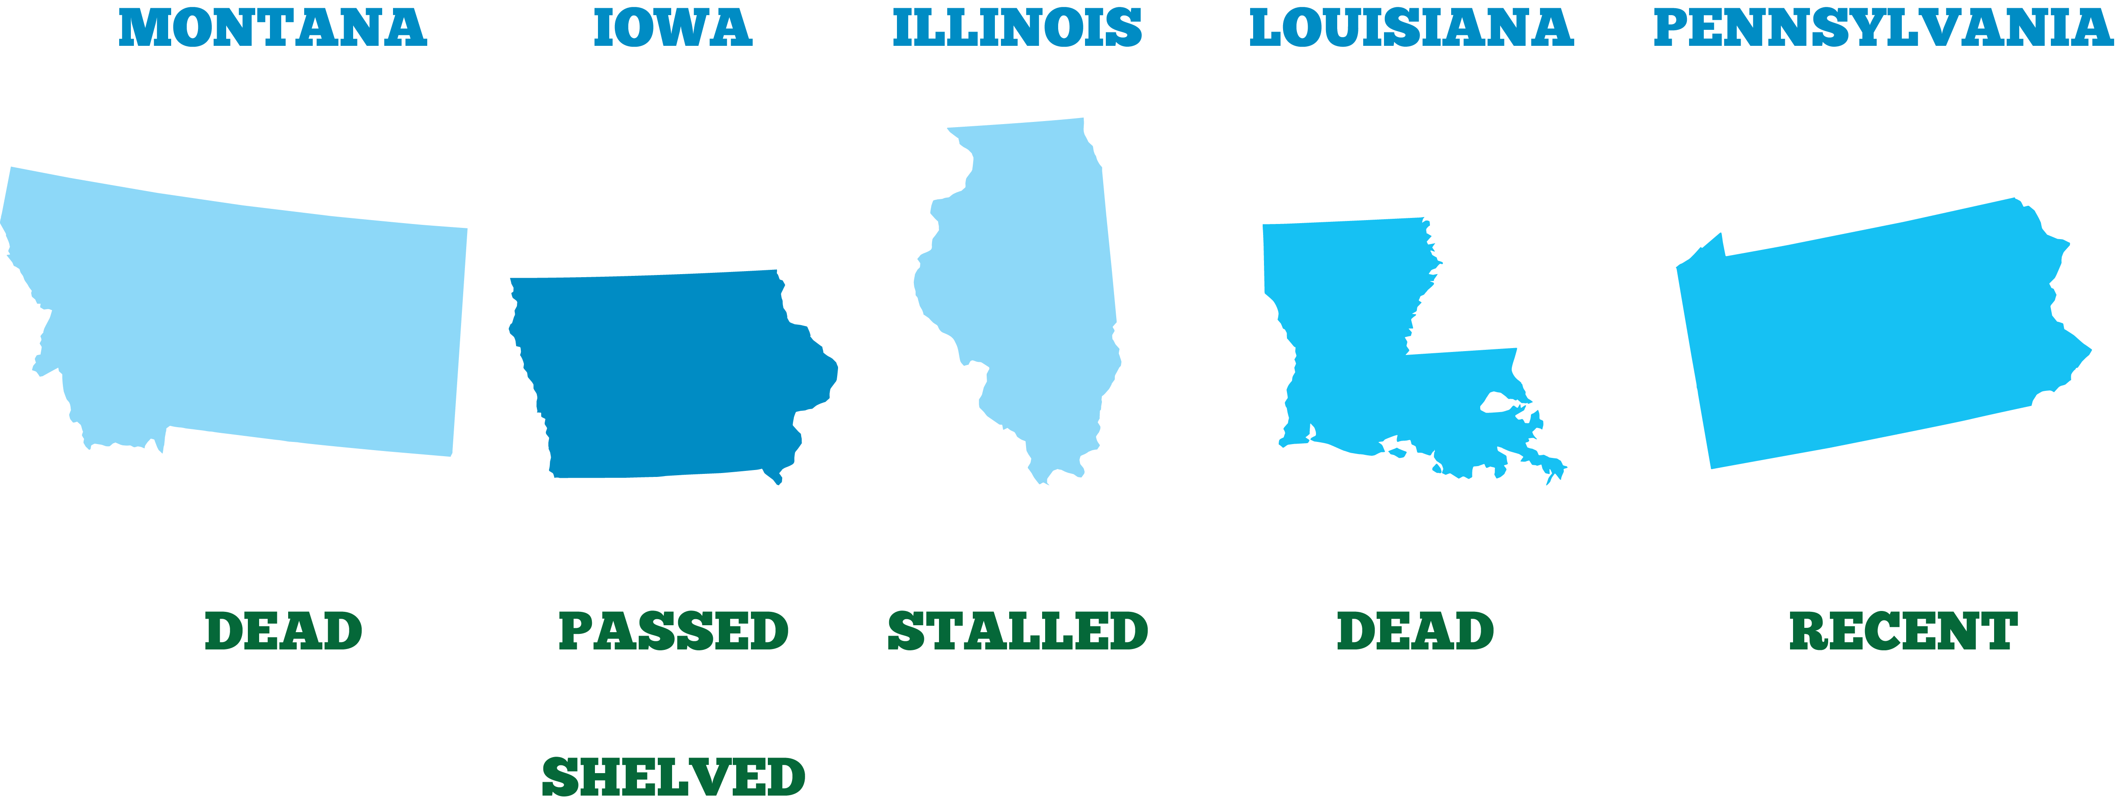
Current and Pending Legislation
HB 181
SF 166
HB 4200
HB 475
HB 1197
HF 281

Slide 4
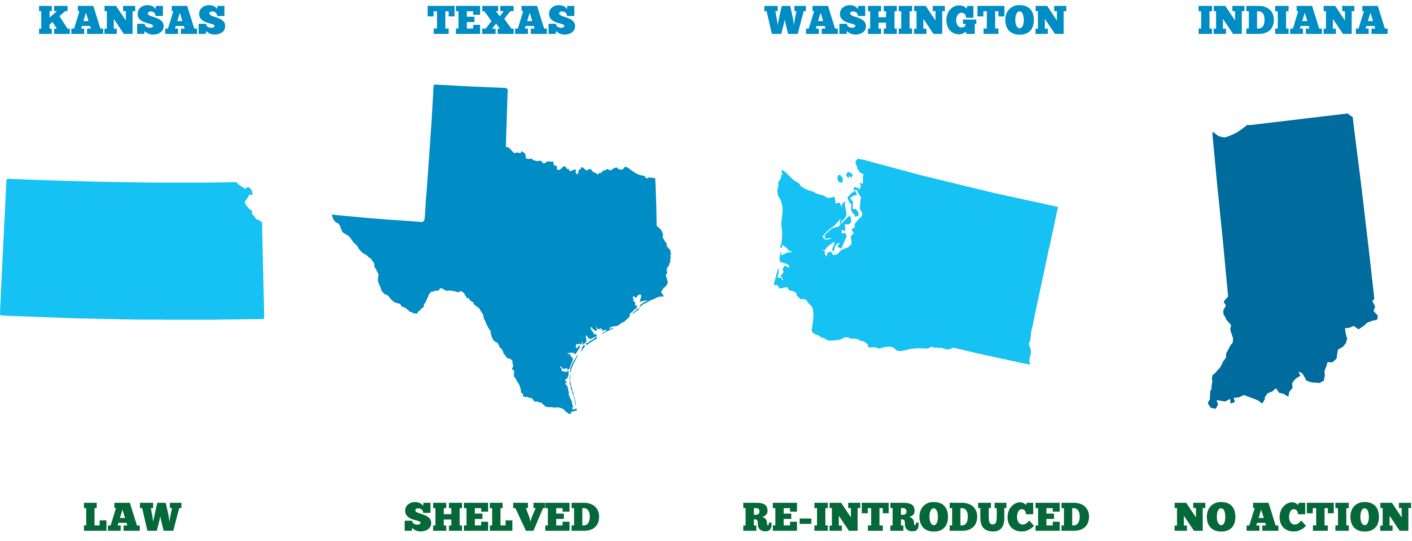
Current and Pending Legislation
HB 2155
HB 4019 / HB 4040
SB 5284 / HB 1301
HB 1074

Slide 5
New Developments

Slide 6
Model Regulation

Slide 7
An Ideal Framework
Consumer Protection
Trade Association
Enforcement
Tax Protection

