Slide 1
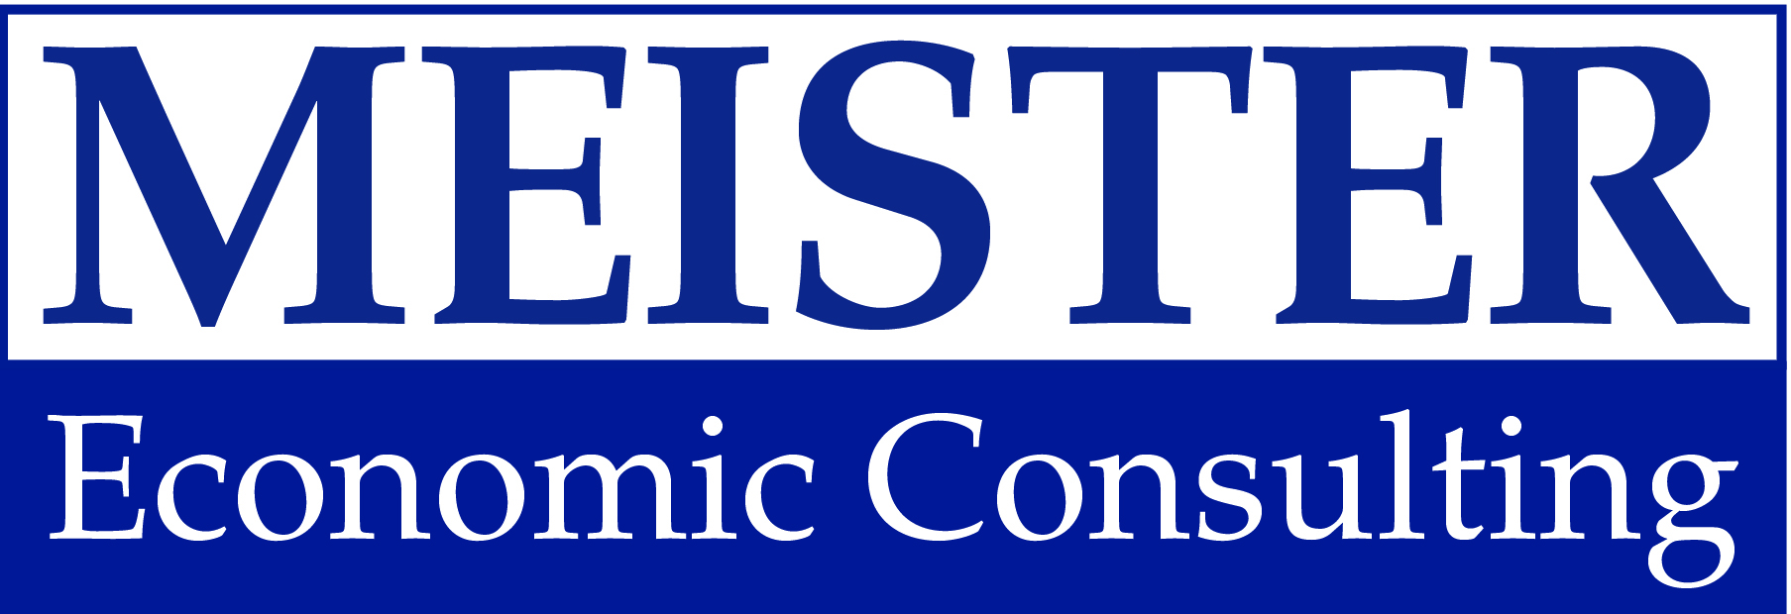
EGR Power Summit September 12, 2019
Tribal Focus:
Looking at new gaming opportunities

Slide 2
Size of the Tribal Market

Slide 3
Healthy Market, Moderate Growth
246 tribes; 500+ gaming facilities of varying size & scope
Currently $33B+ annually in gaming revenue
Over past 15 years, gaming revenue more than doubled
Post-recession growth fell to single digits; down from pre-recession growth of 15%
Growth varies significantly across tribes/markets/states
Tribes are satisfied, but in need of new frontiers

Slide 4
Tribes with Locations in More Than One State

Slide 5
Multi-State Partnership Opportunities
Fort Mojave Indian Tribe (NV and AZ)
Navajo Nation (NM and AZ)
Omaha Tribe of Nebraska (IA and NE)
Pokagon Band of Potawatomi Indians (IN and MI)
Quechan Indian Tribe (AZ and CA)
Sisseton-Wahpeton Oyate of the Lake Traverse Reservation (SD and ND)
Standing Rock Sioux Tribe (ND and SD)
Winnebago Tribe (IA and NE)
Wyandotte Nation (OK and KS)
Arizona
California
Iowa
Indiana
Kansas
Michigan
North Dakota
Nebraska
New Mexico
Nevada
Oklahoma
South Dakota

Slide 6
What is Holding Back Tribes?

Slide 7
Tribal Hesitations
Already doing great on gaming machines & tables
Inherent risks for new types of gaming
Low margin games
Perceived potential for cannibalization of existing revenue
Legal/regulatory concern: may need to renegotiate gaming compacts with states; some tribes do not want to do so
Restrictions on management contracts

Slide 8
Lessons From Tribes in the Market

Slide 9
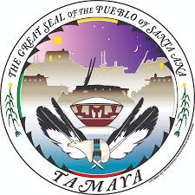
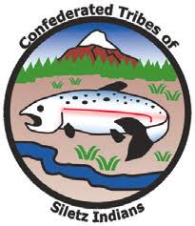
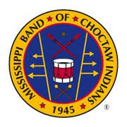
Tribes Who Jumped In
Iowa
Mississippi
New Mexico
New York
Oregon

Slide 10
What States are Next?

Slide 11
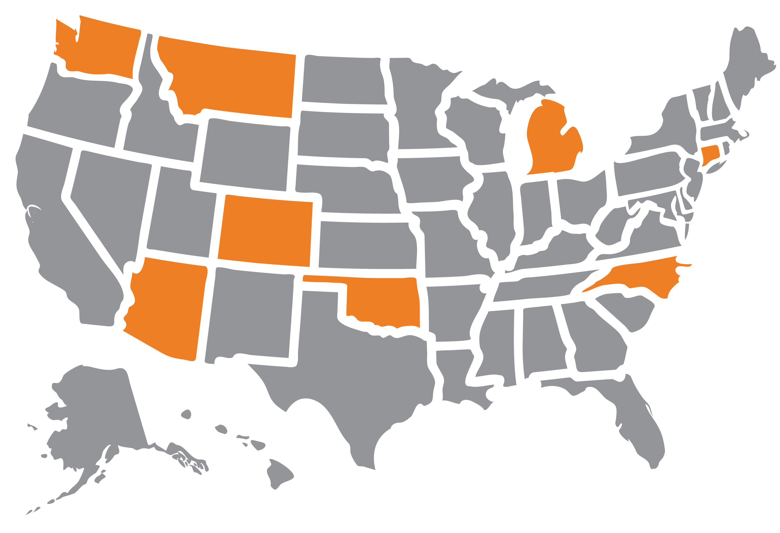
What States are Next?
WA
MT
MT
M I
M I
CT
CO
CO
NC
AZ
OK
AZ

Slide 12
Questions or Comments?

