Slide 1

Cryptocurrency for Regulated iGaming and Sports Betting
Jeff Ifrah
Founding and Managing Partner, Ifrah Law

Slide 2

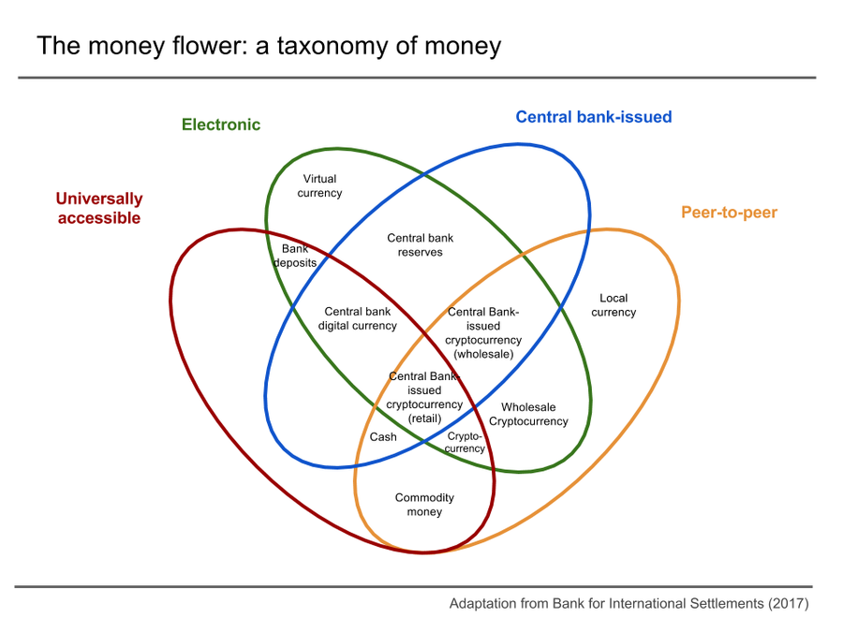
Cryptocurrency is Money
Store value and mediums of exchange
Most states regulate under money transmitter laws
IRS considers it “property”
for tax purposes
Businesses may be considered money services business by U.S. FinCEN

Slide 3

Cryptocurrency Can Generate New
Online Gaming Users
State regulators and commissions do not permit cryptocurrencies as an acceptable method of payment or funding

Slide 4
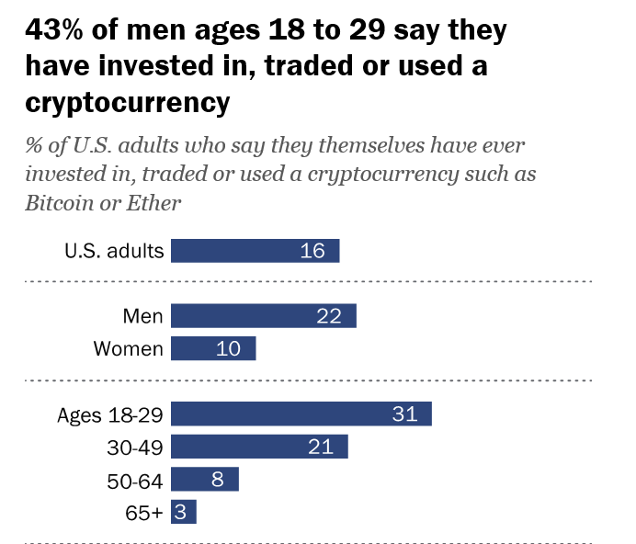
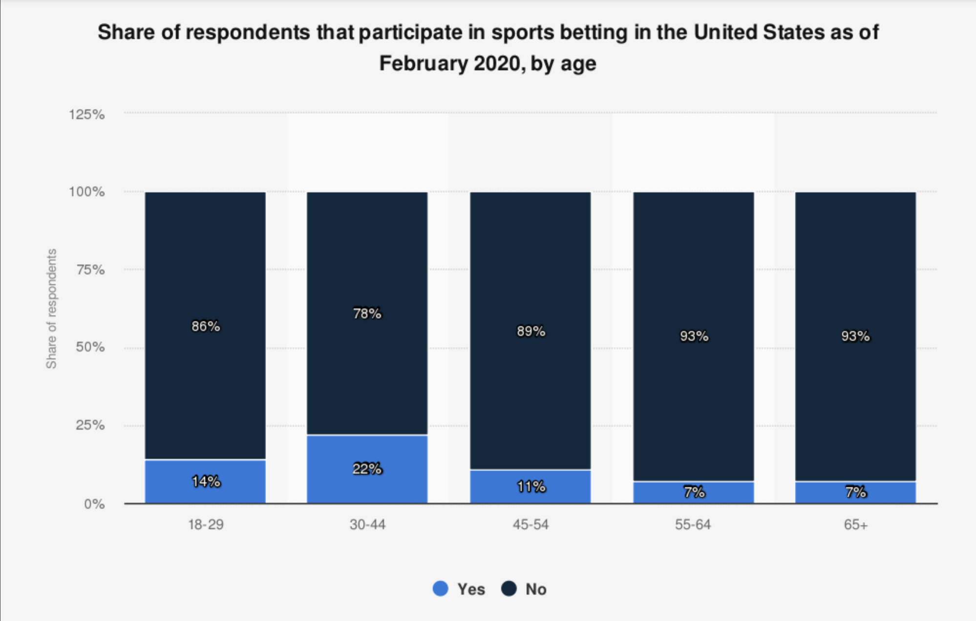
Cryptocurrency Can Generate New
Online Gaming Users

Slide 5


Case Study: Wyoming
Leading pro-crypto and -blockchain state legislature in U.S.
First to approve crypto as a funding method for sports wagering
First to have legal cryptocurrency banks
First to regulate DAOs and recognize as a form of LLC

Slide 6
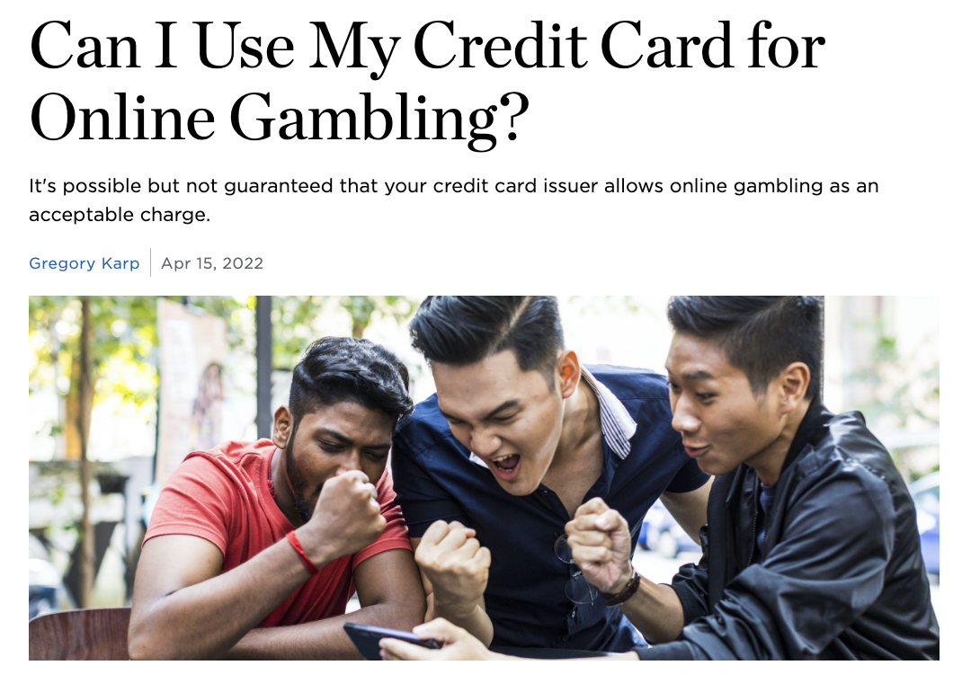
Payment Issues in the U.S.
Credit cards slow to accommodate burgeoning online gaming industry, leaving less options for users to participate.
Some states do not permit credit cards as a payment method (e.g. New York, Connecticut)

Slide 7

Look to 2023 for more crypto options

