Slide 1
Sports Integrity &
Sports Betting
Jeff Ifrah, Jill Exley, David Purdum, & Quirino Mancini
International Masters of Gaming Law
April 12th, 2024

Slide 2
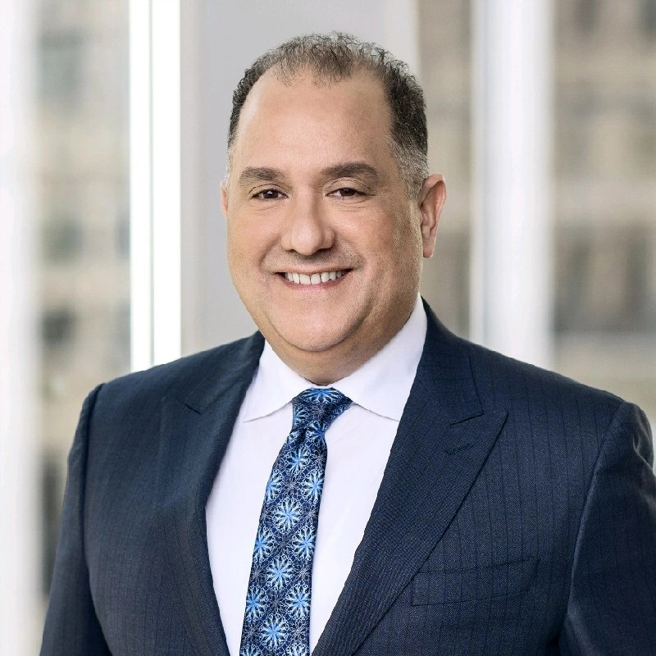
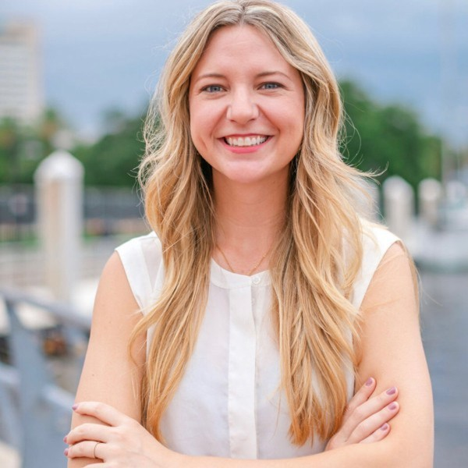
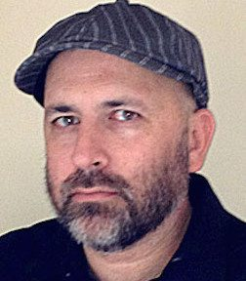
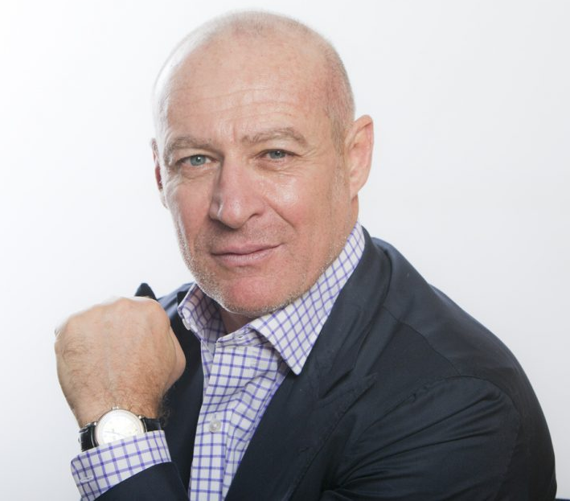
The Panel
Jeff Ifrah
Founding Partner of Ifrah Law and Founder of iDEA Growth
Jill Exley
Integrity Partnerships Director of North America, SportRadar
David Purdum
Journalist, ESPN
Quirino Mancini
President of IMGL, Global Head of Gaming and Gambling Practice at Tonnuci & Partners

Slide 3
What is Sports Integrity?
Sports Integrity: competitive sporting events conducted in accordance with the rules in the spirit of fairness (honesty) and best effort.
Threats to sports integrity include cheating, doping, match-fixing, point-shaving, insider-betting, insider-tipping, etc.

Slide 4
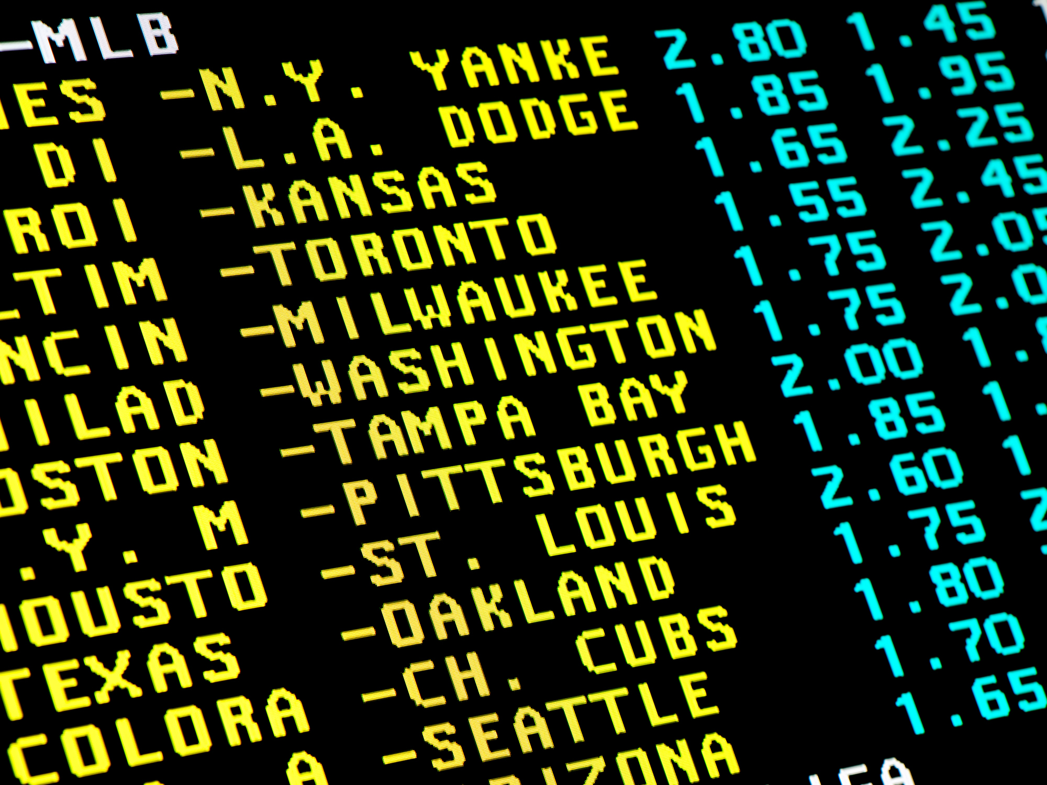
Regulated Sports Betting Helps Preserve Sports Integrity

Slide 5
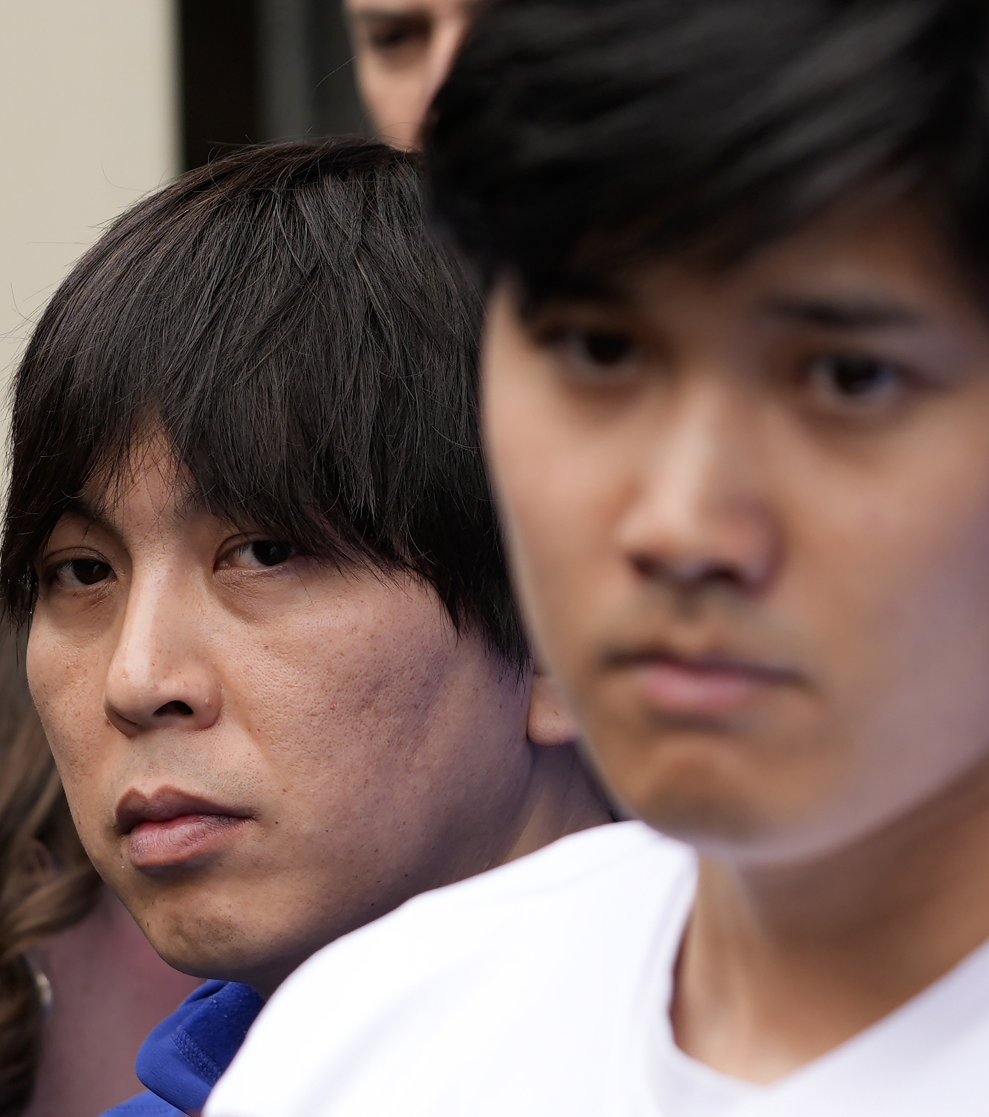
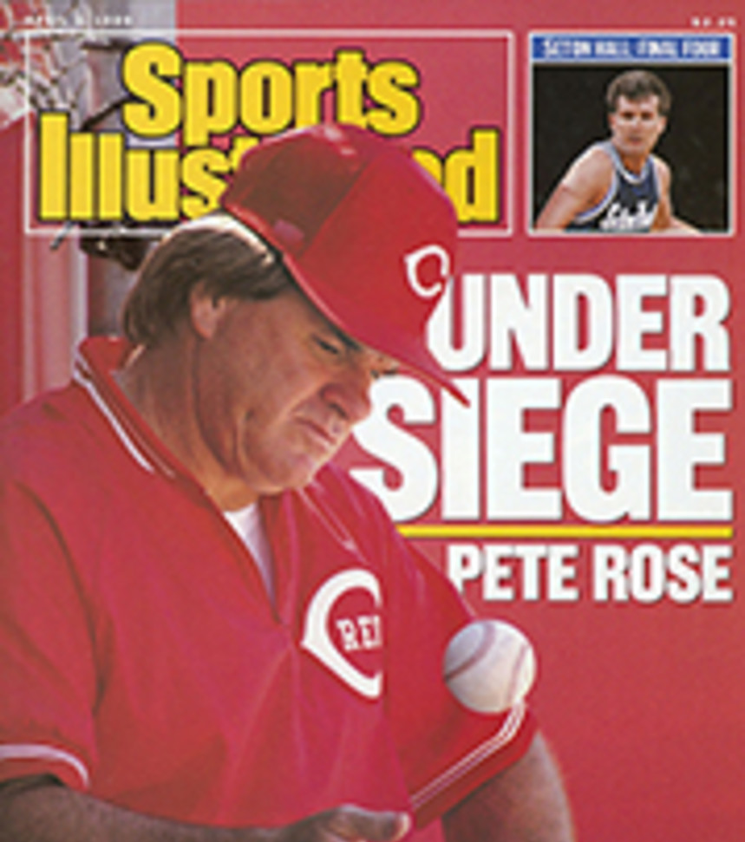
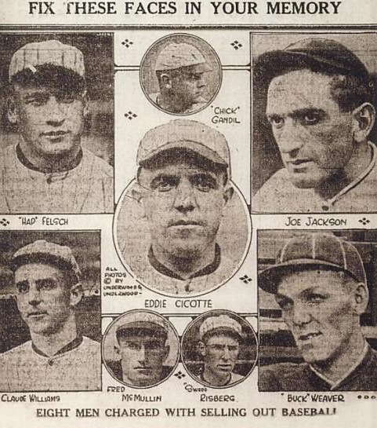
Sports Integrity & Sports Betting in North America

Slide 6
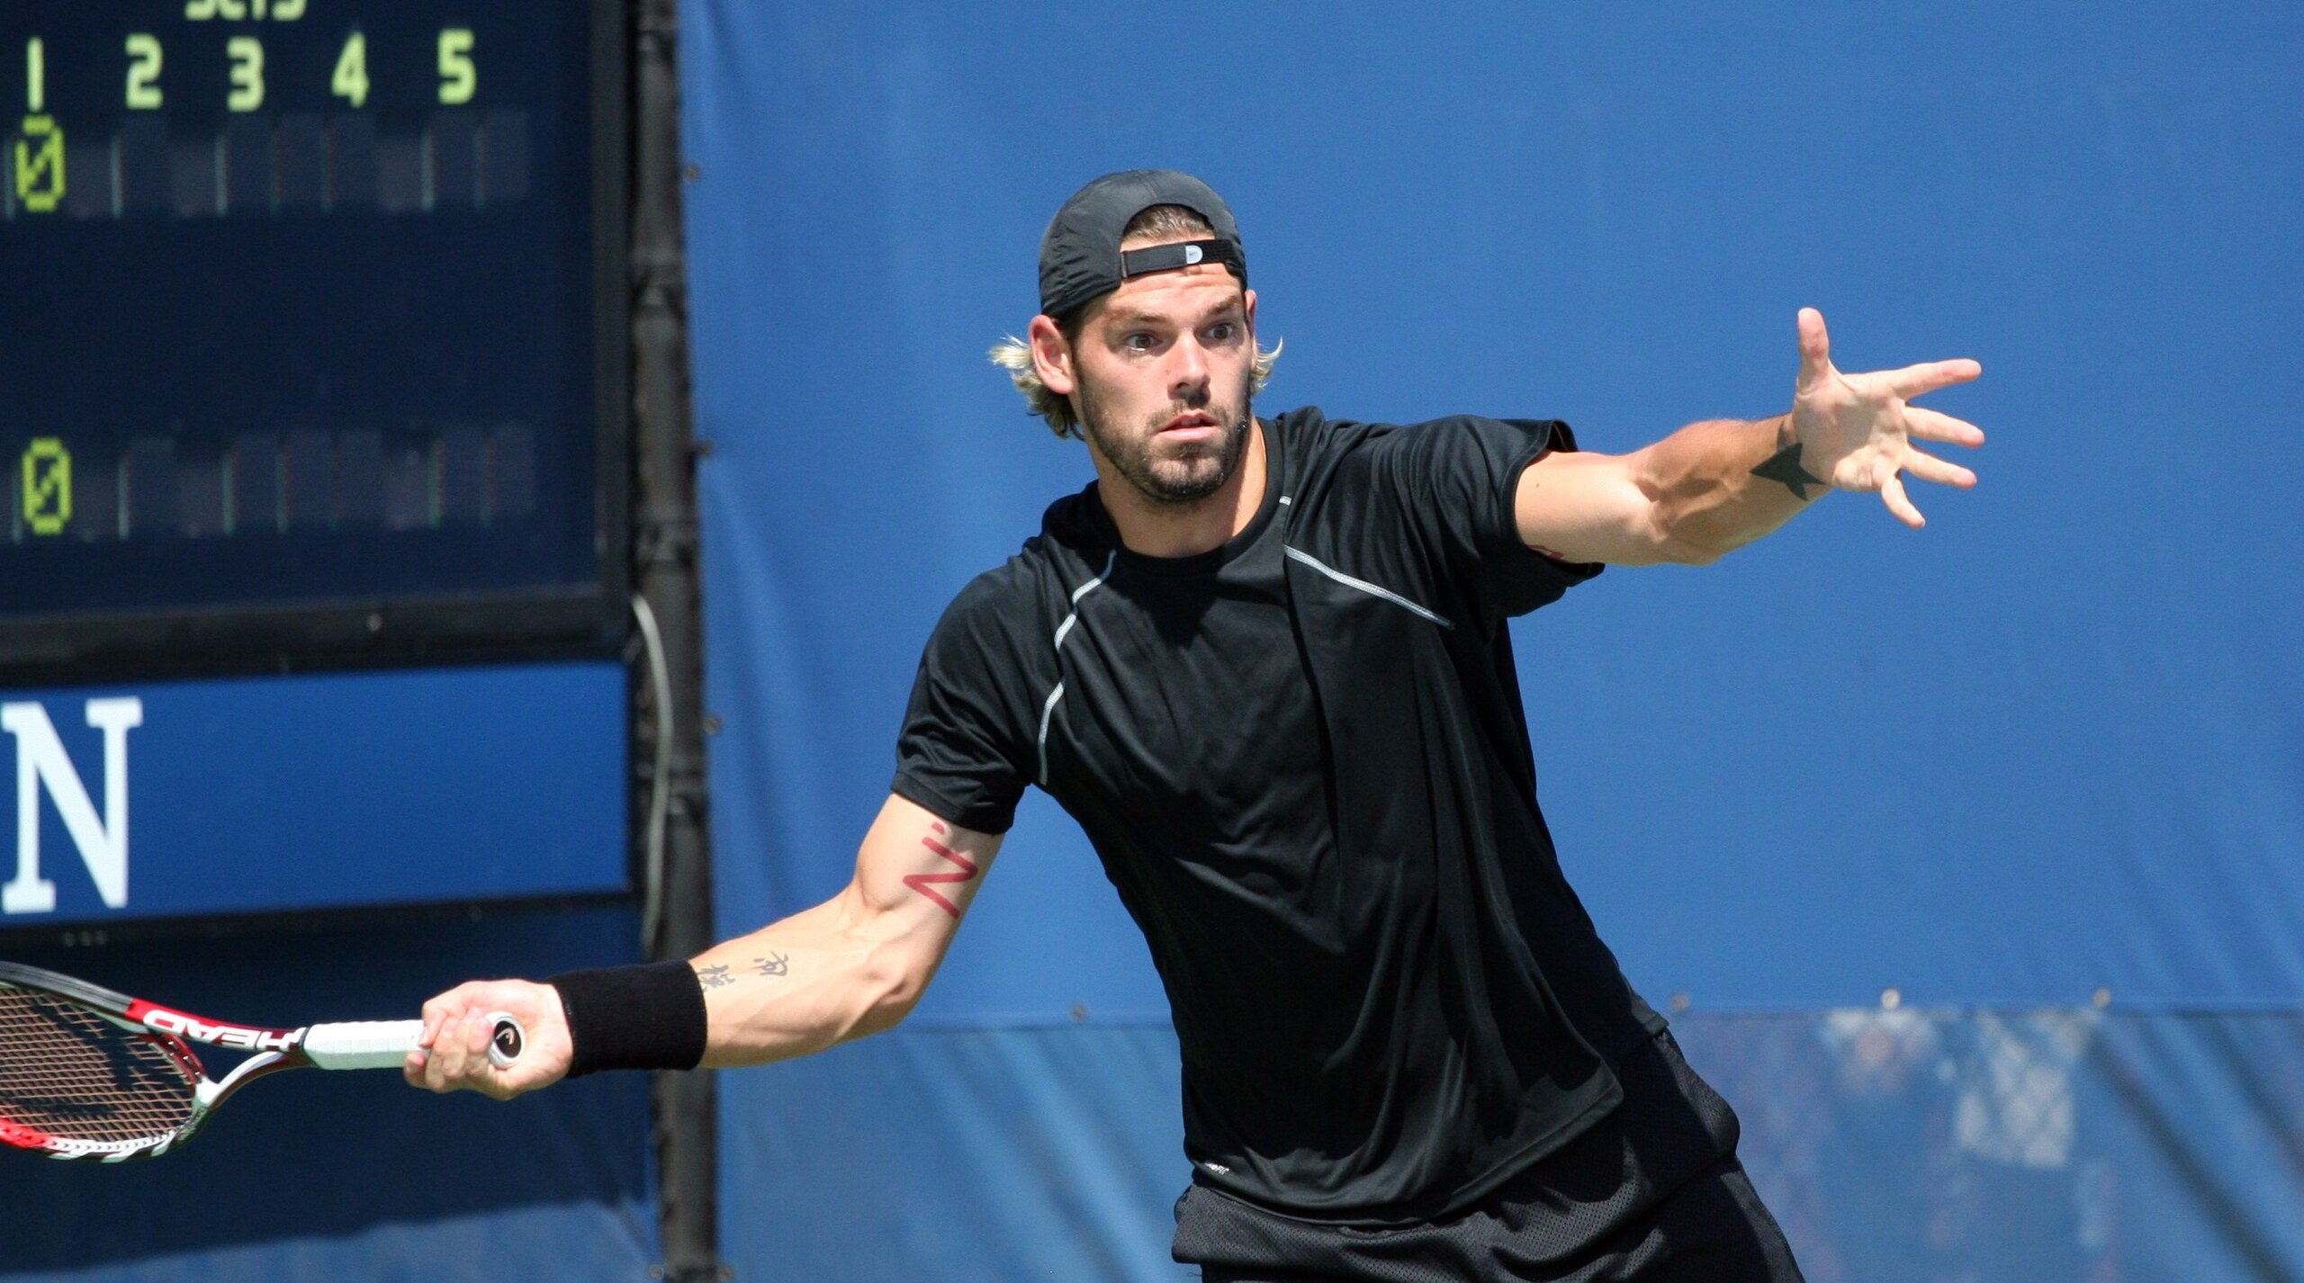
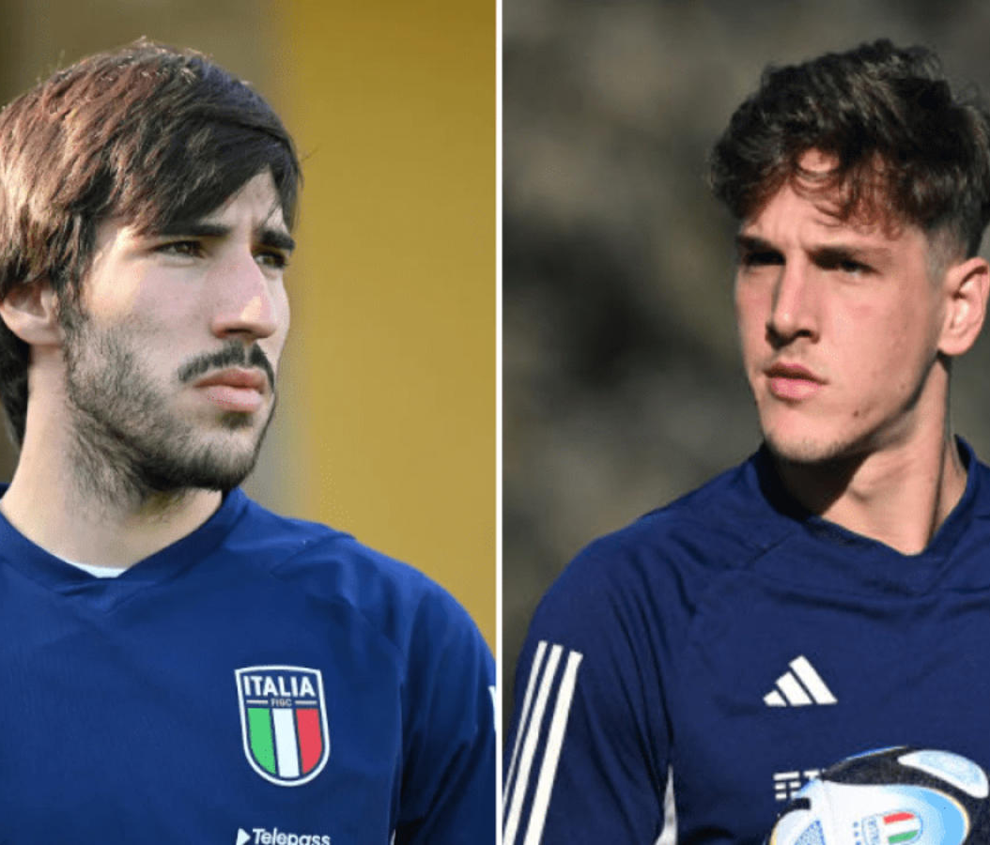
Sports Integrity & Sports Betting in Europe

Slide 7
SportRadar’s Work on Betting Corruption & Match-Fixing
SportRadar’s Universal Fraud Detection System (UFDS)
Analyzes odds from 600+ global sportsbooks
Monitors accounts for 130+ sportsbooks
Used by 100+ sports bodies, clubs, law enforcement agencies

Slide 8
Evidence of Sports Integrity
SportRadar’s “Betting Corruption and Match-Fixing Report”:
Covered 850,000 sporting events and matches across 70 sports
Identified 1,329 suspicious matches in 11 sports across 105 countries
99.5% of sporting events displayed no suspicious activity
No sport over 1% suspicious rate worldwide
Only 35 matches in North America had suspicious activity

Slide 9
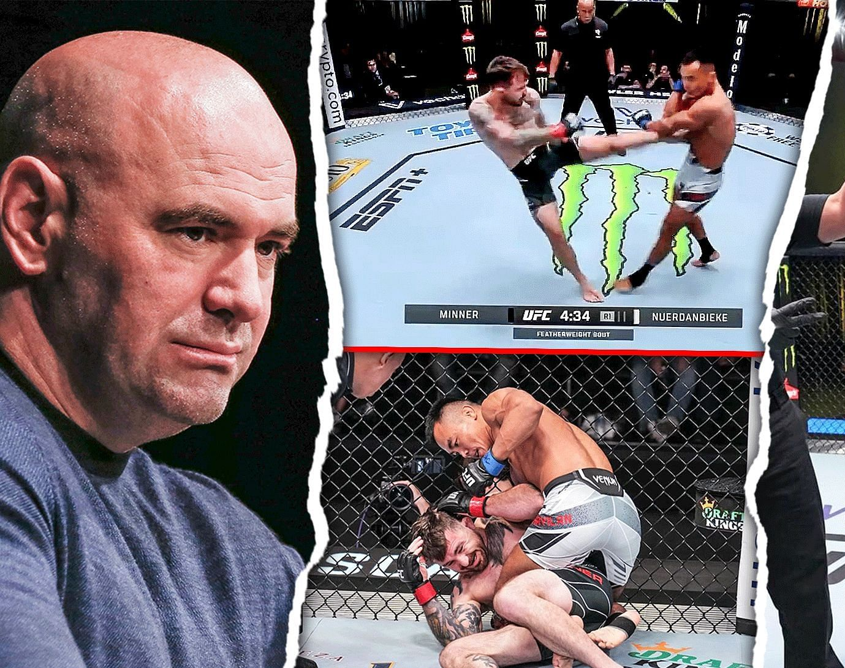
Case Study: UFC in 2022
Unusual odds shift detected pre-fight flagged by sportsbooks
Investigations found undisclosed injury rumors spread to bettors who capitalized on the opportunity
Actions taken:
Regulators suspended UFC wagers temporarily
Coach banned by UFC, involved fighters released
Notes:
DP:
-How often is suspicious activity we see in the news just a result of rumors getting out, insiders tipping bettors off?
JE:
-So, how do you work with regulators and sports leagues in situations like these? Do you basically hand over everything you know after you've verified data as suspicious activity? Or is there more investigative work to be done by SportRadar with regulators and sports leagues?
QM:
-Do you see reports of undisclosed injuries giving rise to suspicious betting activity over in the European press, anything like this UFC case study?

Slide 10
Resources
“What to know about bookies amid the gambling scandal around Ohtani” — David Purdum, ESPN
“Betting Corruption and Match-Fixing Report” — SportRadar’s Integrity Services Division
“Ifrah Law Interviews David Purdum on Sports Integrity” – Jake Gray, Ifrah on iGaming
“Sports Betting Series| Outside the Lines” — SportsCenter, YouTube
“A Positive Result of Legalized Sports Betting is Solution for Betting Corruption and Match Fixing” – Sara Dalsheim, Ifrah on iGaming

Slide 11
Thank you!

